Slide 1
Types of British houses
«МБОУ Гимназия №17» г. Королев
Подготовила:
учитель английского языка
Швецова Татьяна Алексеевна
УМК Spotlight 9

Slide 2
The main types of English houses
a block of flats
a cottage
a caravan
a mansion
a semi-detached house
a terrace(d) house
a detached house
a hut
a farmhouse
a skyscraper

Slide 3
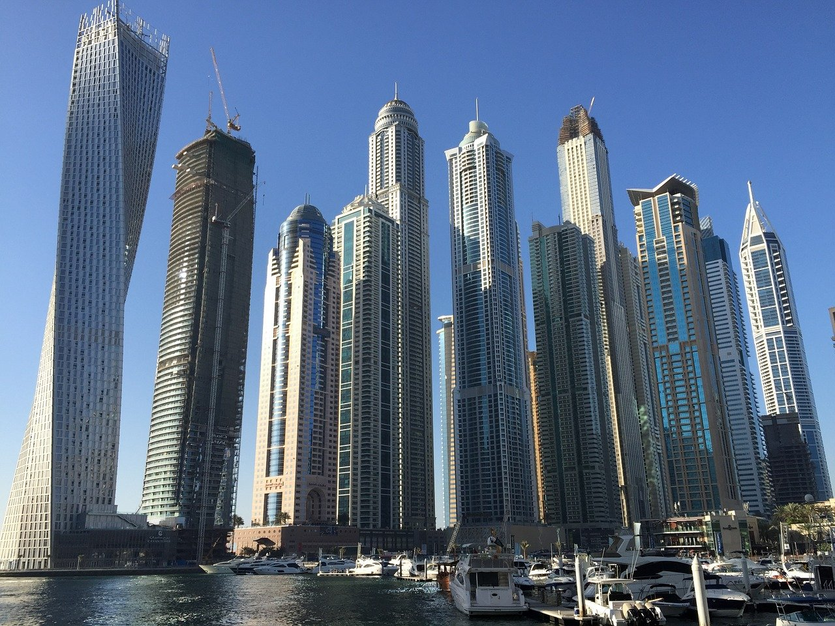
a skyscraper
It is a very tall modern building, usually in a city.

Slide 4
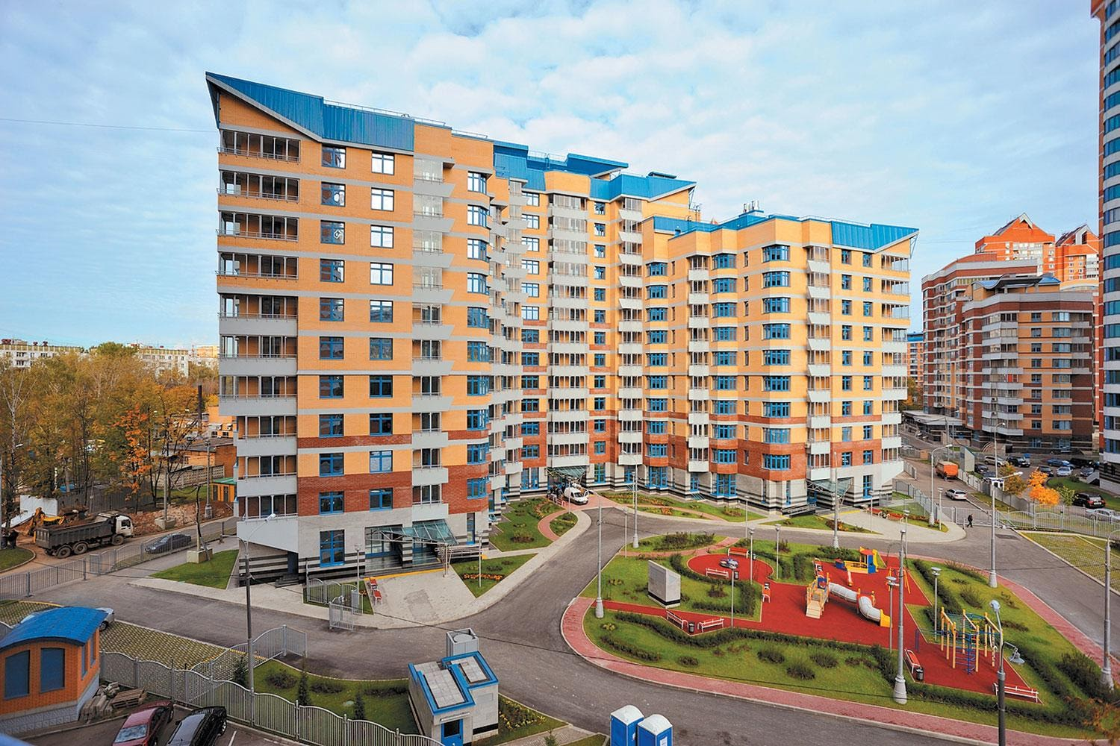
A block of flats
a large building that is divided into separate apartments

Slide 5
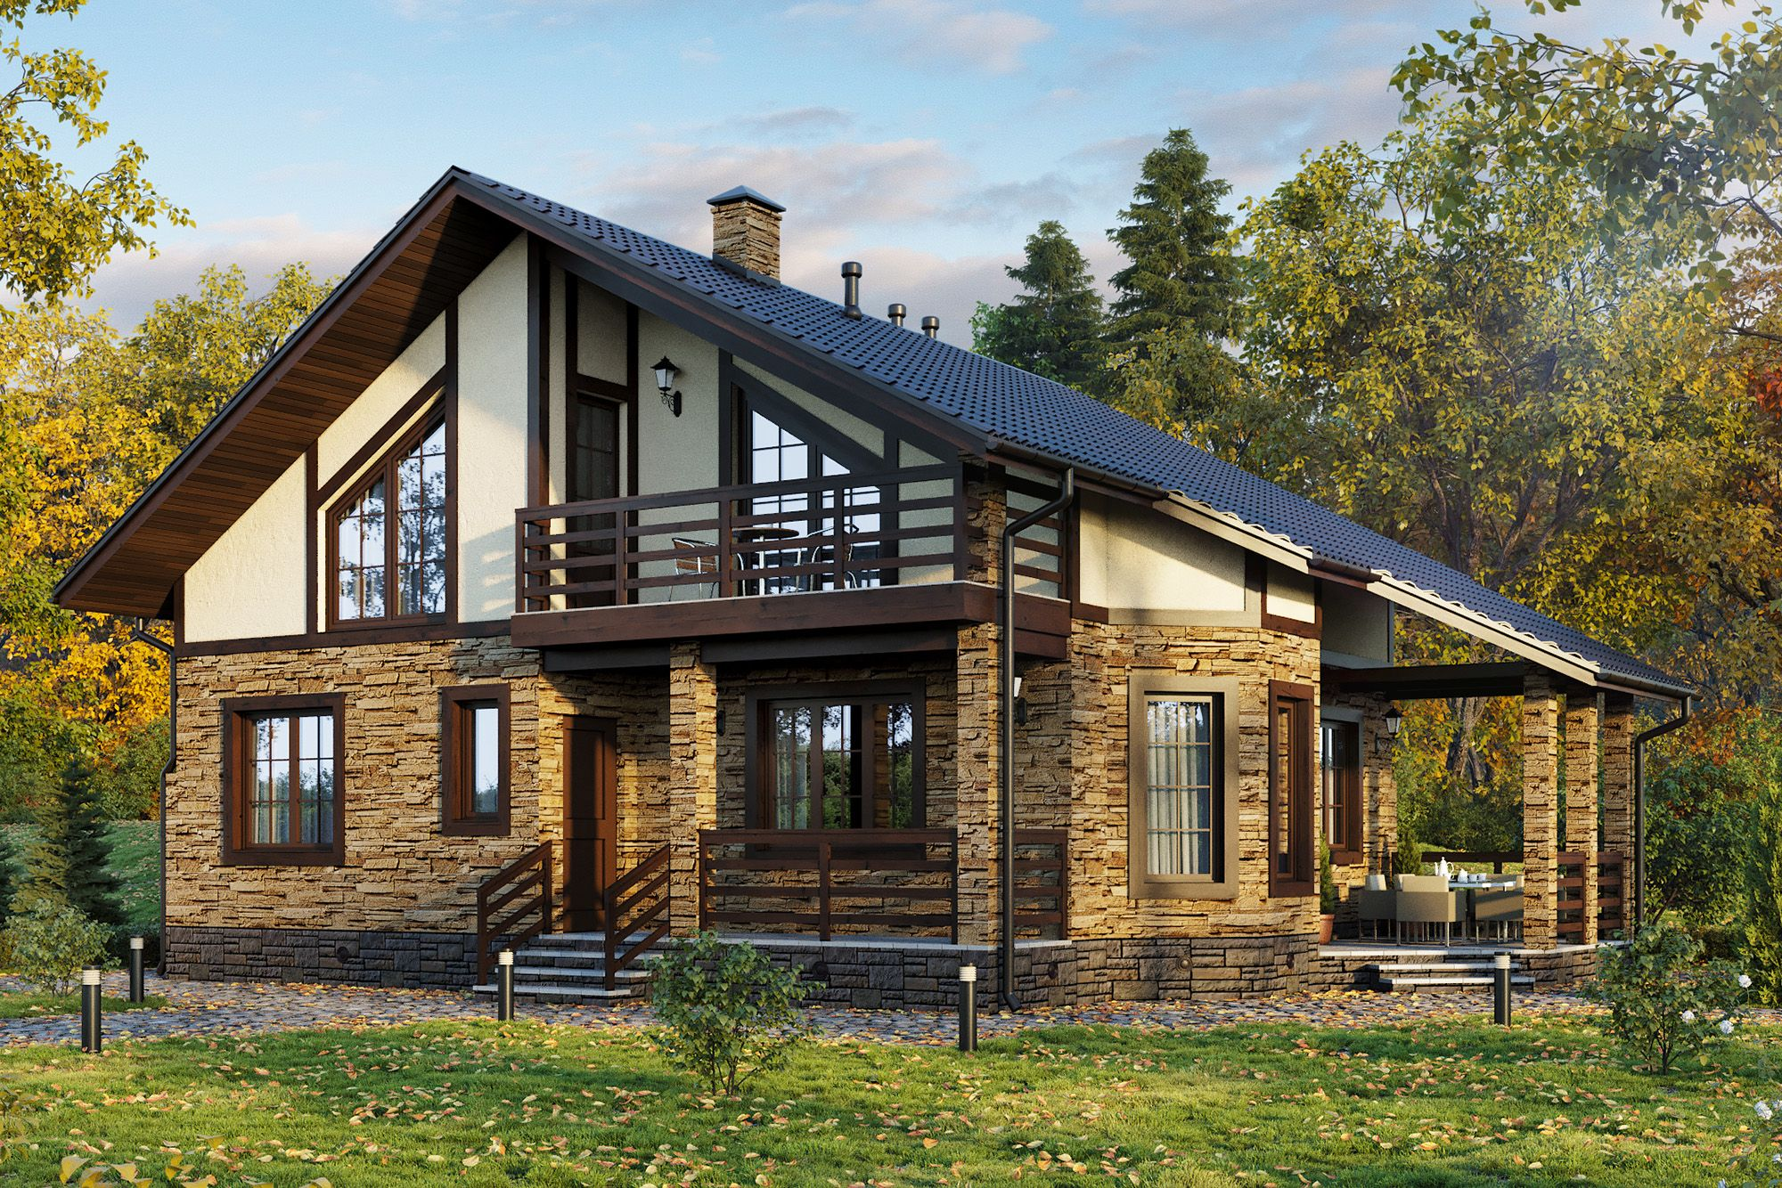
a cottage
a small house, usually in the countryside

Slide 6
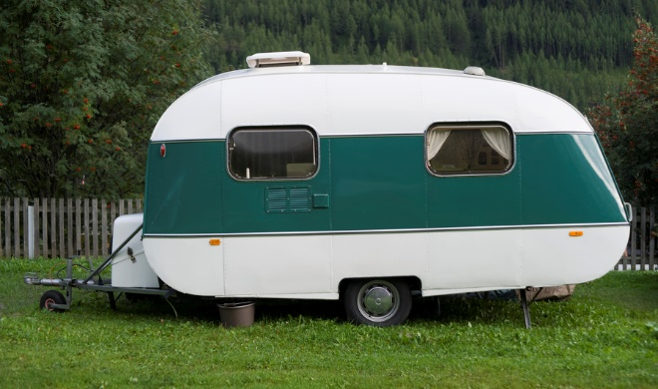
a caravan
It is a wheeled vehicle for living or travelling in, especially for holidays, that contains beds and cooking equipment and can be pulled by a car.

Slide 7
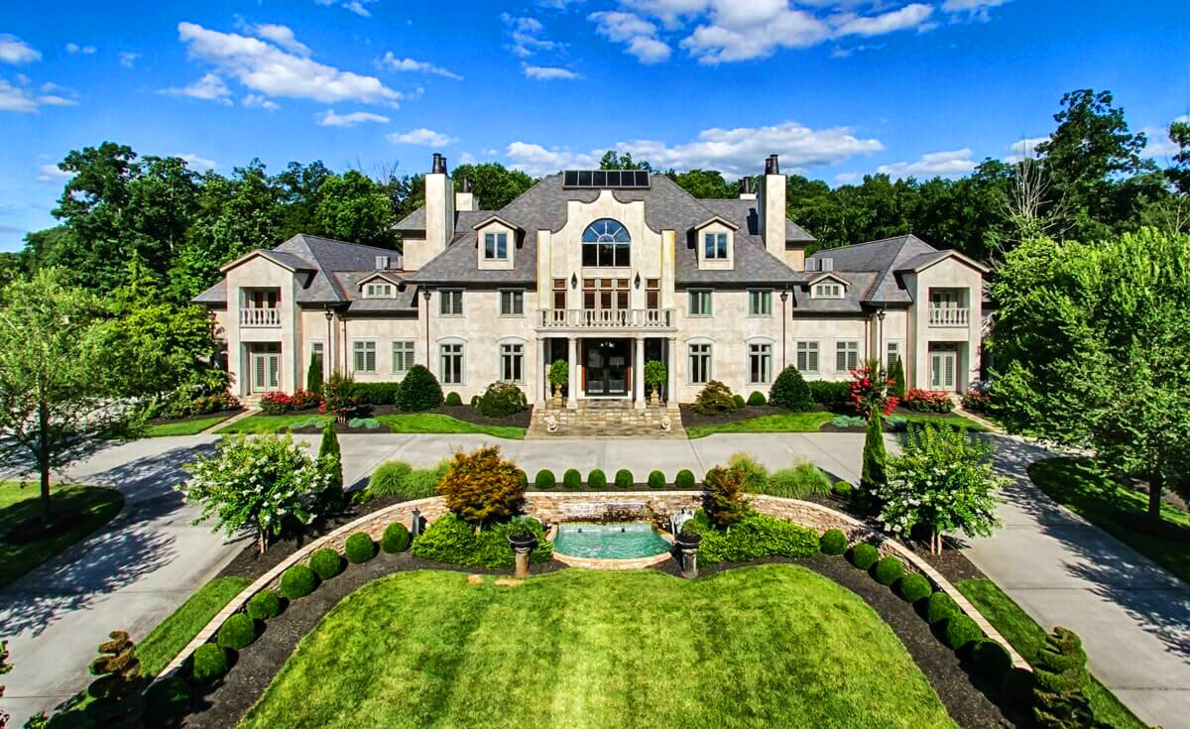
a mansion
It is a very large, expensive and impressive house. It is a large house of a wealthy person.

Slide 8
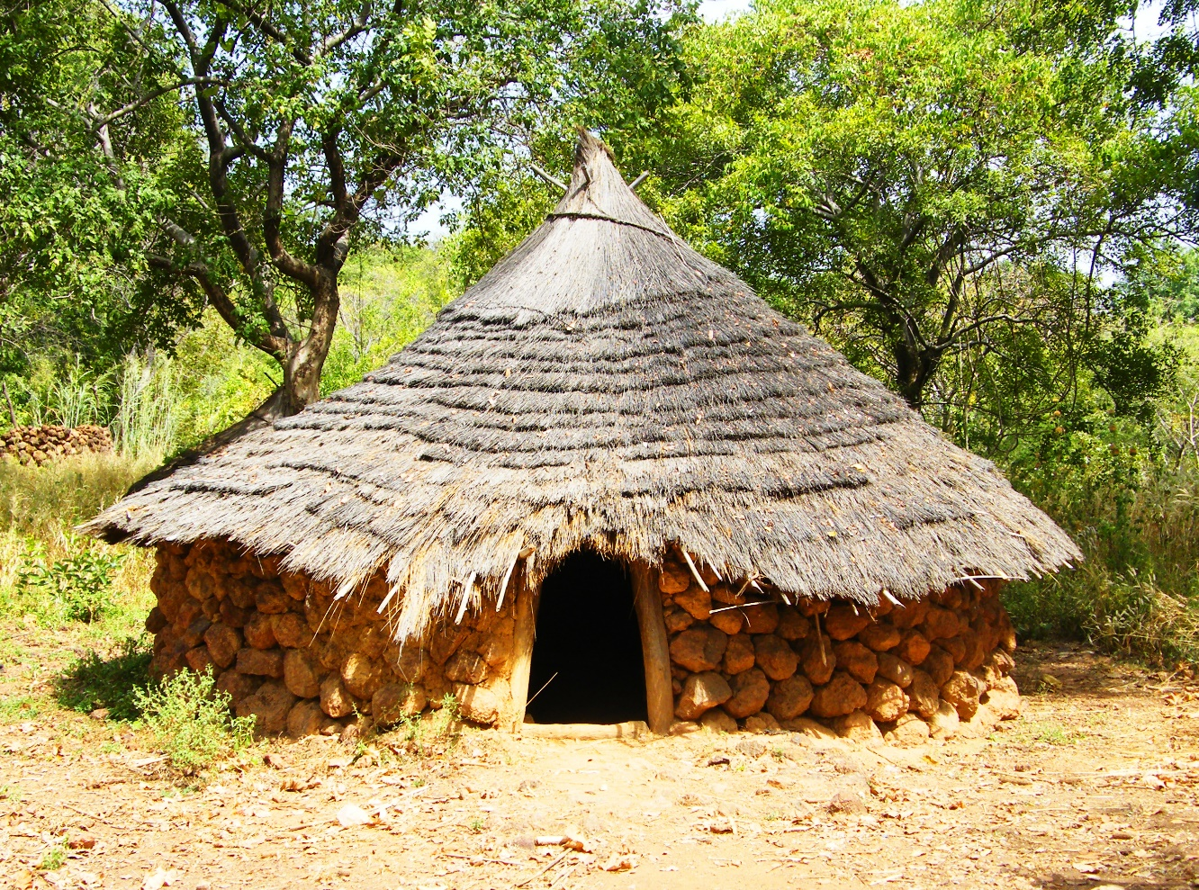
a hut
It is a small, simple building, usually consisting of one room. It is made of natural materials as of logs or grass.

Slide 9
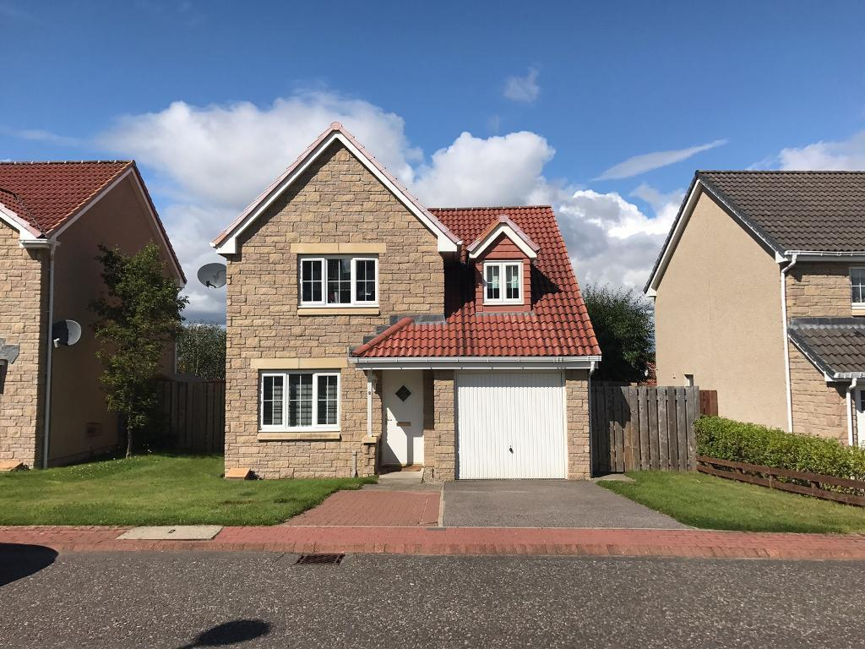
a detached house
This house is not connected to any other building.

Slide 10
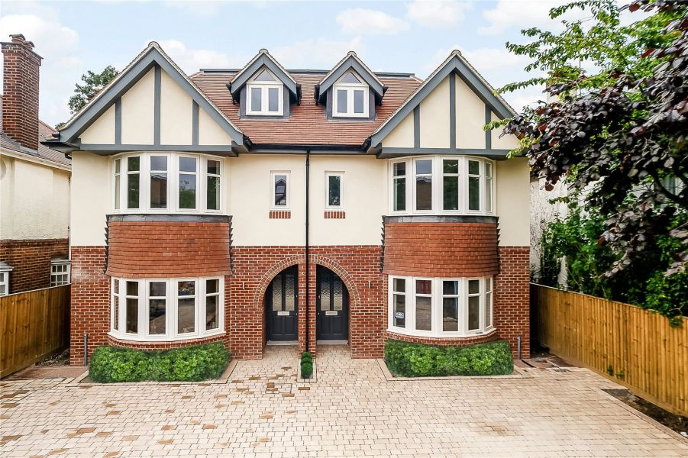
a semi-detached house
It is a house which is joined to another house on one side.

Slide 11
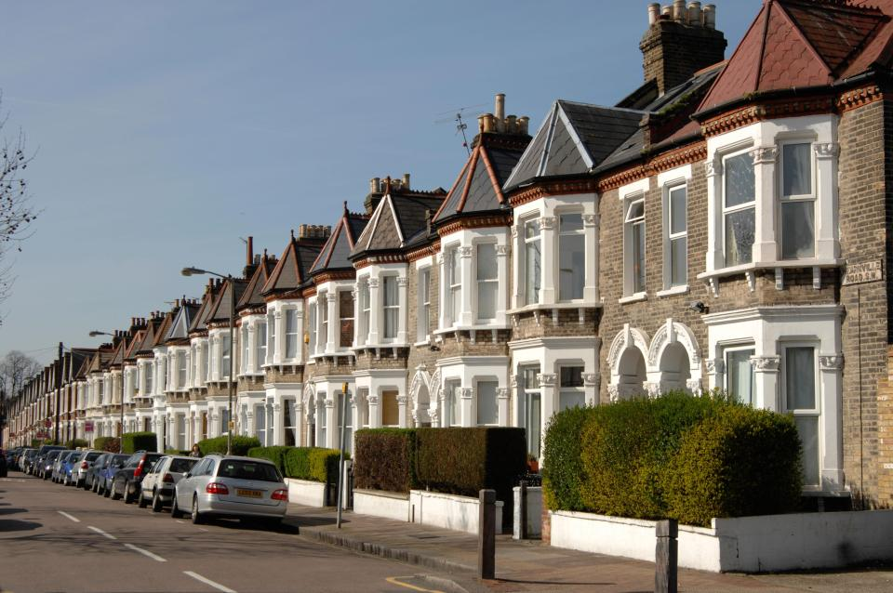
a terrace(d) house
It is a house which is joined to other houses on two sides.

Slide 12
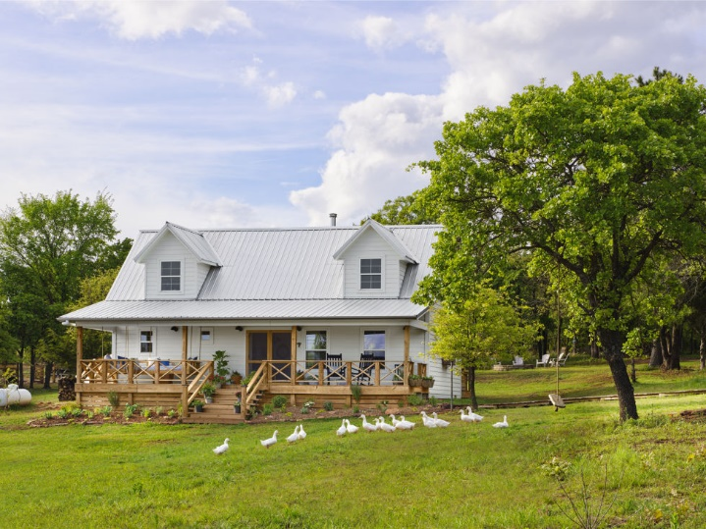
a farmhouse
It is the main house on a farm where the farmer lives.

Slide 13
What type of house would you prefer to live in? Why?

