Slide 1
Year after year
Подготовила:
учитель английского языка
МБОУ Гимназии№17
Швецова Татьяна Алексеевна
УМК Spotlight 5

Slide 2
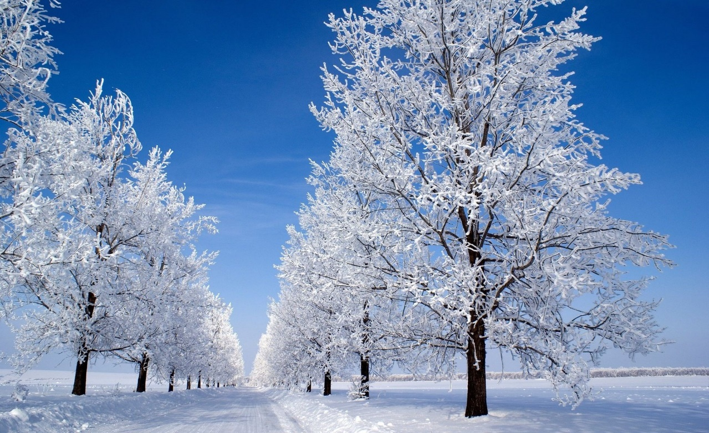
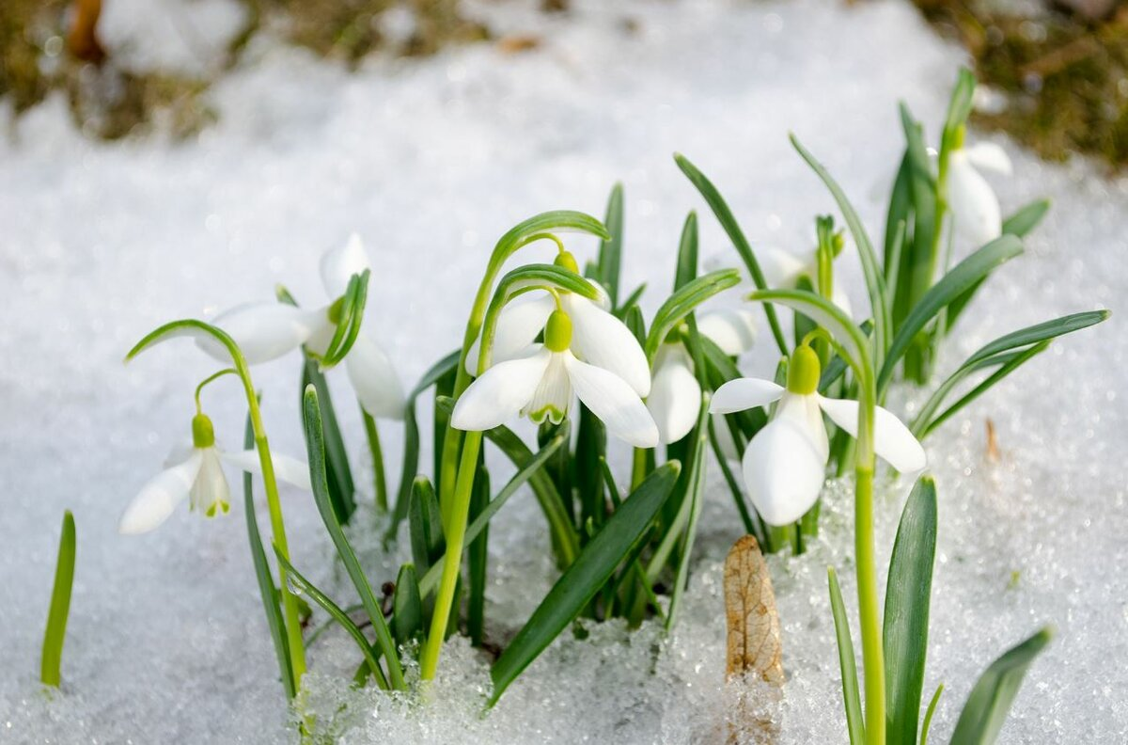
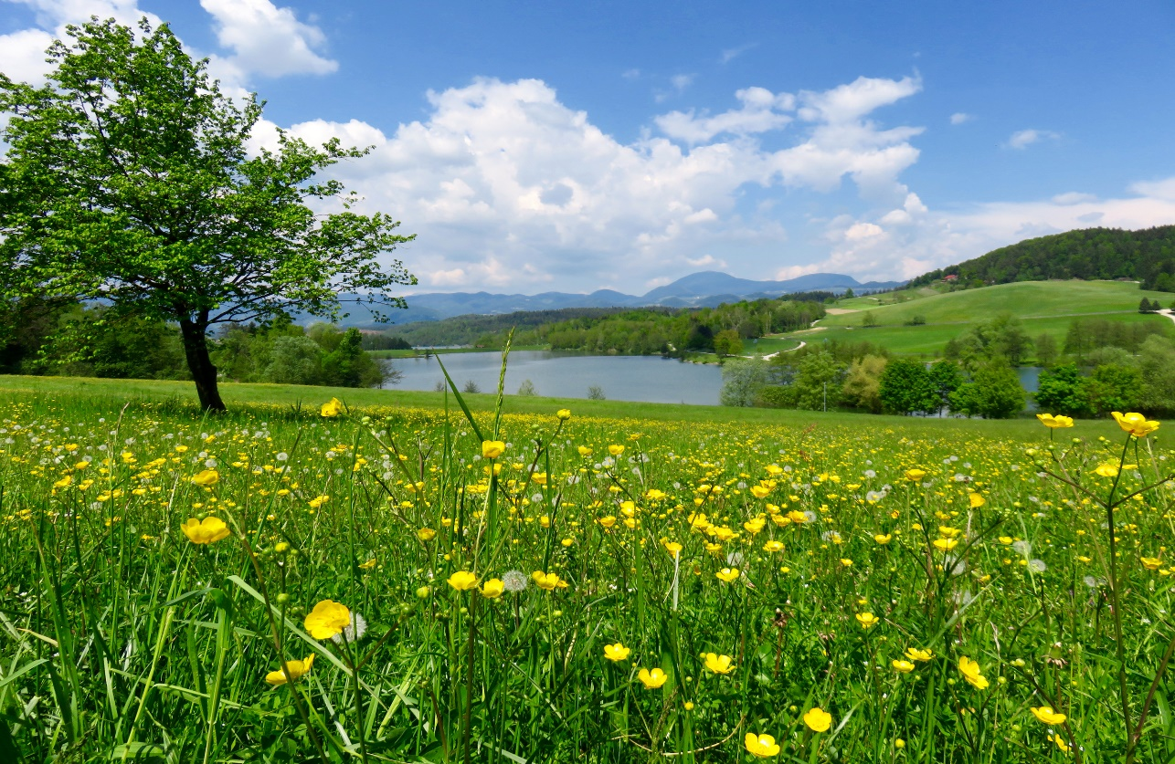
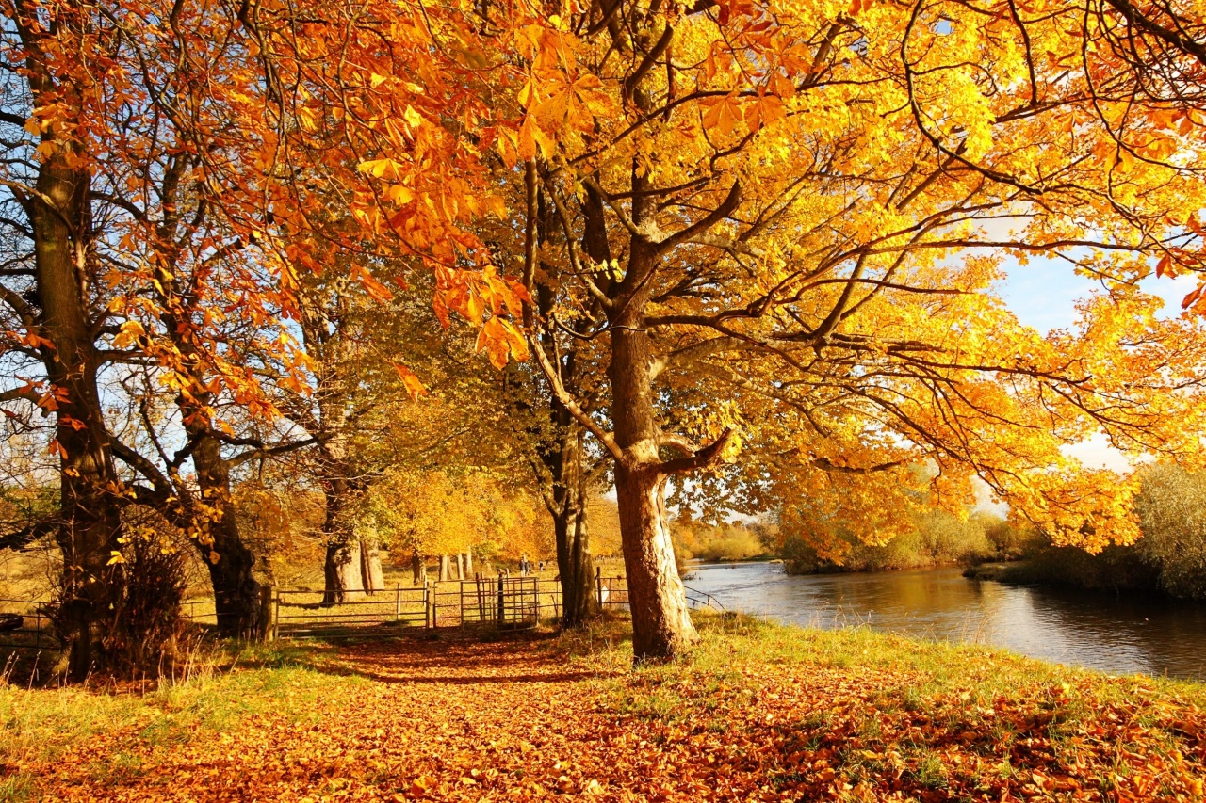
Winter
Spring
Summer
Autumn

Slide 3
What season is it?
It often rains. The leaves are brown, red, yellow and they are falling.
It’ s autumn.
It is warm. The birds are singing. There are small green leaves on the trees.
It’s spring.
It is very cold. The ground and trees are white.
It’s winter.
It is hot and sunny. There are many flowers.
It’s summer.

Slide 4
Winter months are…
DECEMBER
JANUARY
FEBRUARY

Slide 5
SPRING months are…
MARCH
APRIL
MAY

Slide 6
SUMMER months are…
JUNE
JULY
AUGUST

Slide 7
AUTUMN months are…
SEPTEMBER
OCTOBER
NOVEMBER

Slide 8
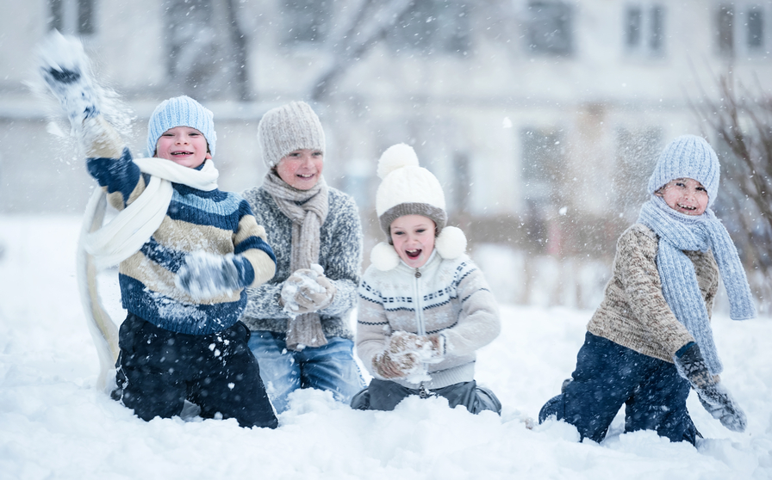
It’s winter
What months are there in winter?
What is the weather like in winter?

Slide 9
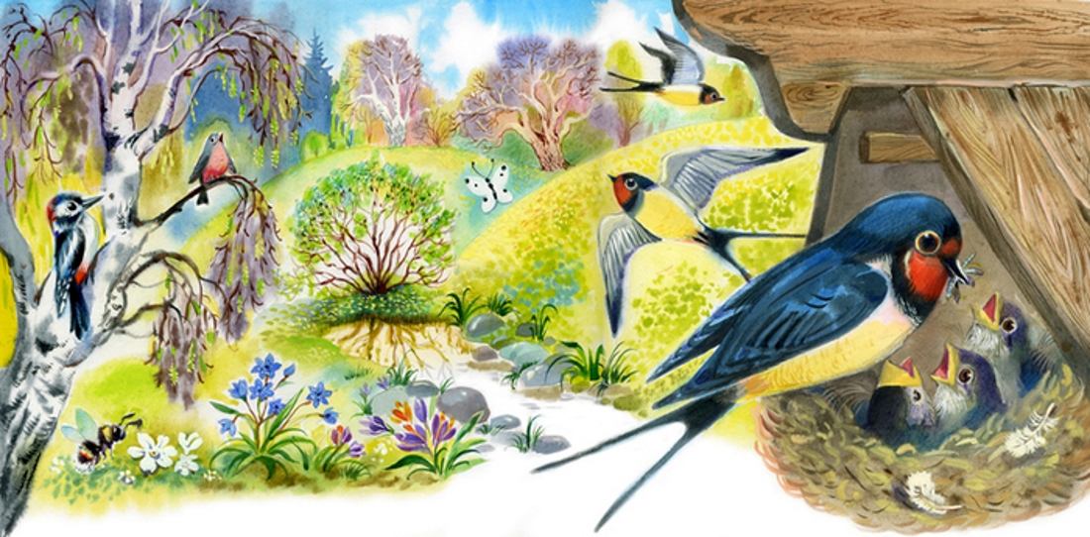
It’s Spring
What months are there in spring?
What is the weather like in spring?

Slide 10
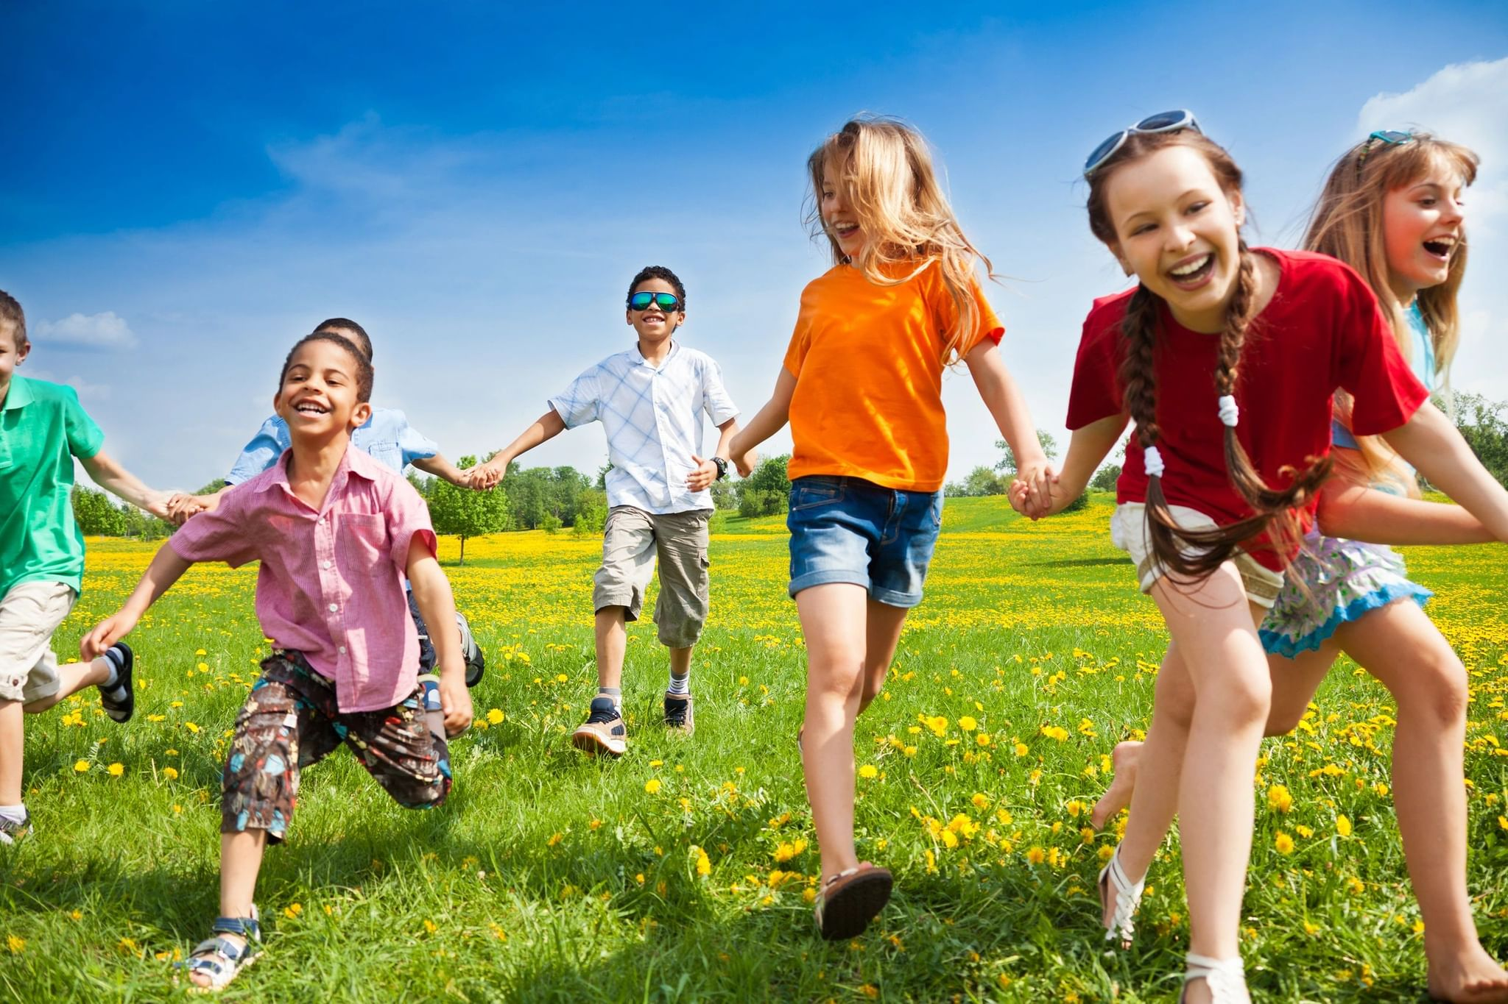
It’s summer
What months are there in summer?
What is the weather like in summer?

Slide 11
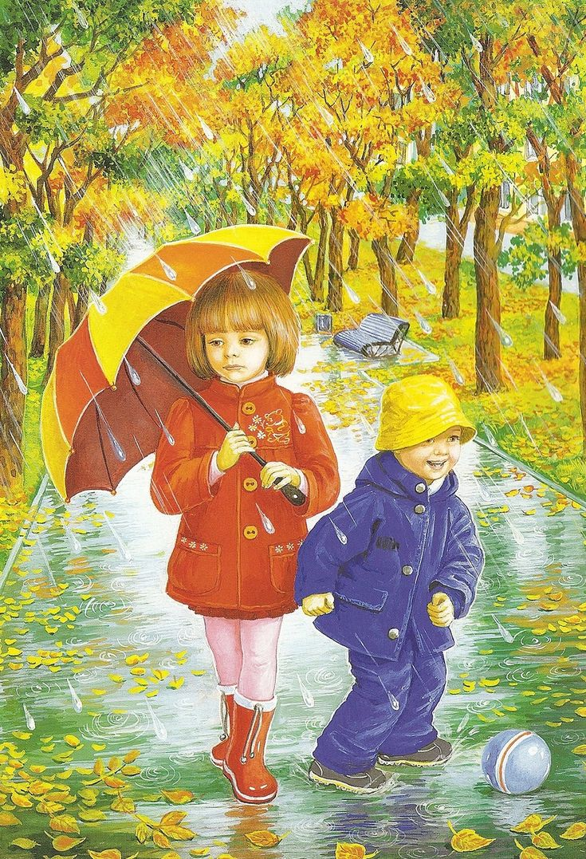
It’s autumn
What months are there in autumn?
What is the weather like in autumn?

Slide 12
WHAT IS YOUR FAVOURITE SEASON?
WHAT IS YOUR FAVOURITE MONTH?

Slide 13
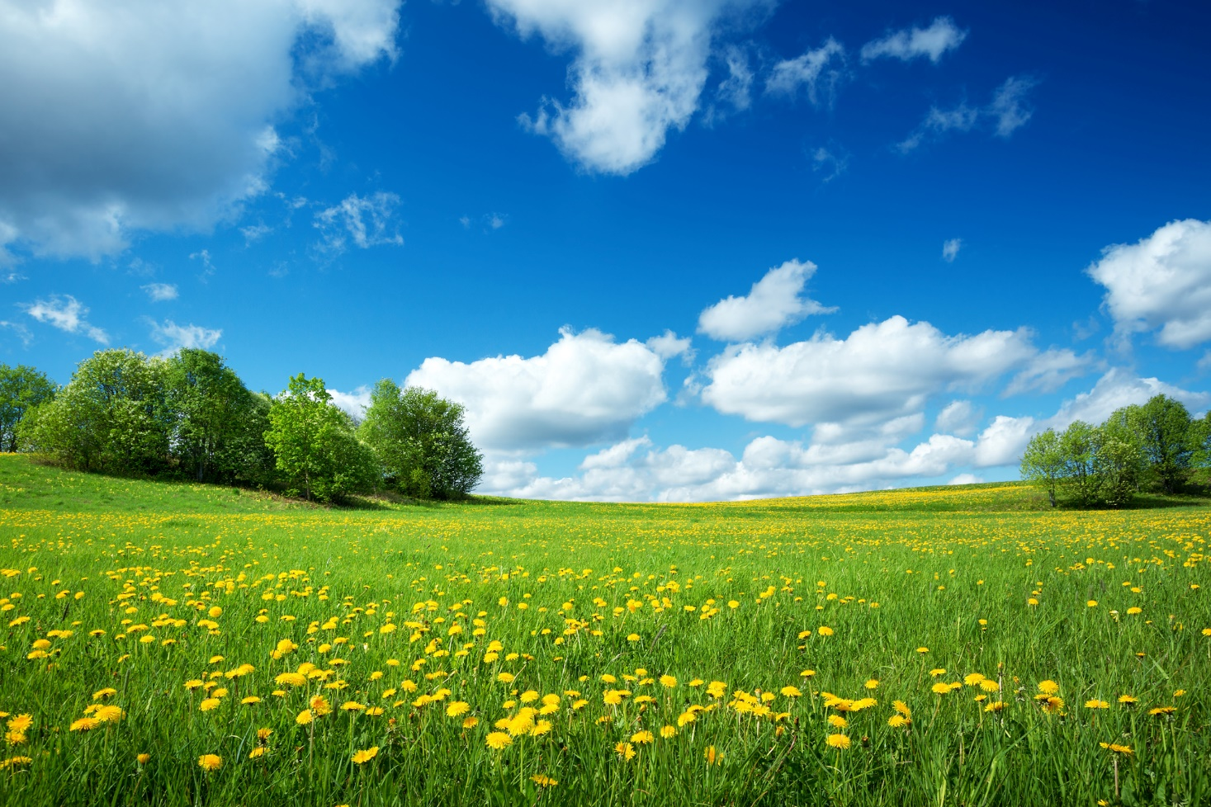
HAVE A NICE DAY

