Slide 1
Module 4.4

Slide 2
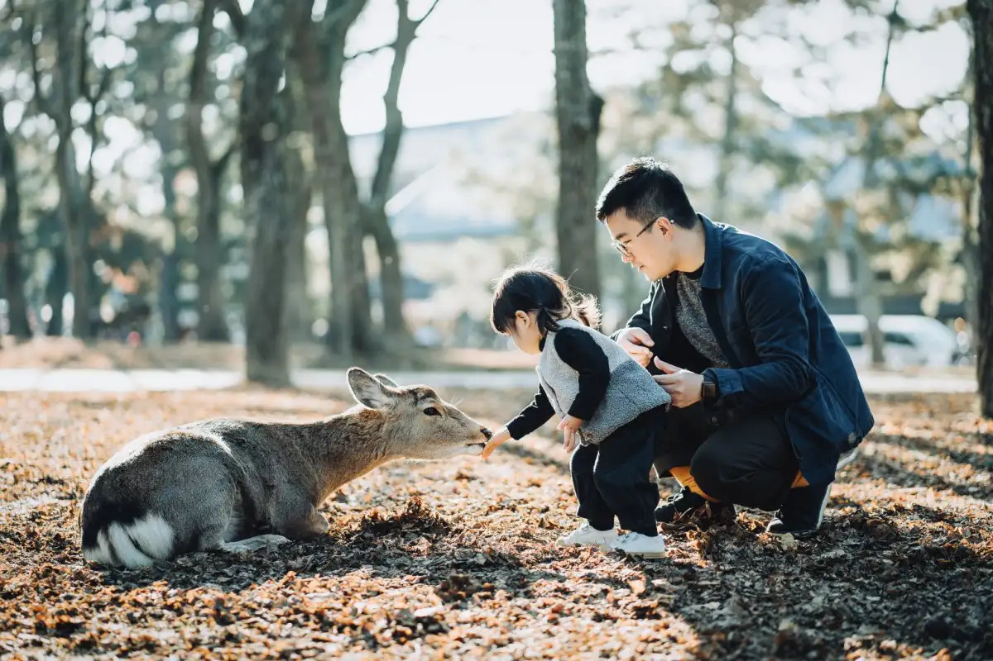
What role do people play in the world? What role do animals play in the world?

Slide 3
Fill in the correct word from the list below. natural, captivity, protect, confine, released, species, breed, extinct
НЕВОЛЯ
ДЕРЖАТЬ ВЗАПЕРТИ
ВИД
РАЗМНОЖАТЬСЯ
Human population expansion and the effects of hunting are threatening many 1) _______ to such an extent that they are almost 2) _______ . In order to 3) _______ them, many animals are kept in 4) _______ in zoos and safari parks. The idea is that when animals are able to 5) _______ in safety, their numbers will increase enough so that some can be 6) _______ into their 7) _______ habitats. Some extreme animal rights activists, however, believe that it is better to allow a species to become extinct than to 8) _______ them in a prison-like zoo.

Slide 4
Fill in the correct word from the list below. natural, captivity, protect, confine, released, species, breed, extinct
Human population expansion and the effects of hunting are threatening many 1) _______ to such an extent that they are almost 2) _______ . In order to 3) _______ them, many animals are kept in 4) _______ in zoos and safari parks. The idea is that when animals are able to 5) _______ in safety, their numbers will increase enough so that some can be 6) _______ into their 7) _______ habitats. Some extreme animal rights activists, however, believe that it is better to allow a species to become extinct than to 8) _______ them in a prison-like zoo.
SPECIES
EXTINCT
PROTECT
CAPTIVITY
BREED
RELEASED
NATURAL
CONFINE

Slide 5
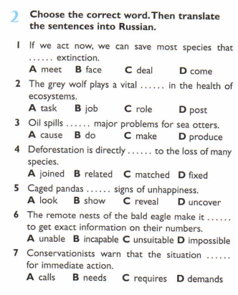
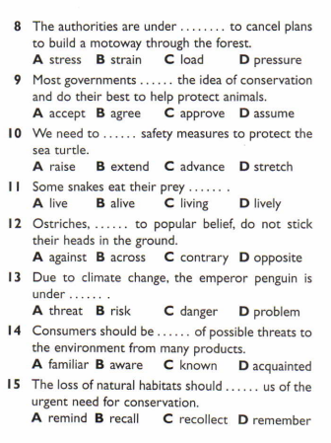
Choose the correct word. Then translate the sentences into Russian.

Slide 6
Choose the correct word
conserve - to protect an environment//keep – to observe
adjust – to modify//match - to be equal
collaborate – to work together //correlate – to compare things and bring them into a relation
extinction = disappearance//destruction = ruin
harm = negative//effect = positive
alone = one//solitary=lonely/single
threats = risk//warnings=alert
endangered – находящийся под вымиранием//troubled=anxious
wiped out = die/kill//disappeared - lost
give – someting to someone//contribute = invested/- to bring

Slide 7
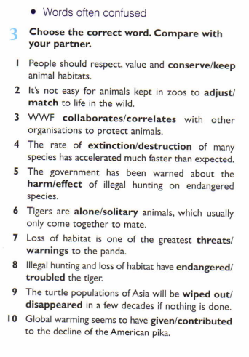
Choose the correct word

Slide 8
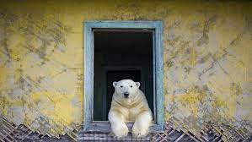
What role do people play in the world? What role do animals play in the world?
https://www.youtube.com/watch?v=Tss6HtHlLuw

Slide 9
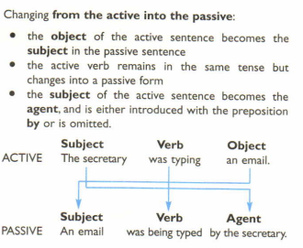
Passive

Slide 10
We use the passive:
When the person or people who do the action are unknown, unimportant or obvious from the context.
When the action itself is more important than the person/people who do it, as in news headlines, newspaper articles, formal notices, advertisements, instructions, processes.
When we want to avoid taking responsibility for an action, or when we refer to an unpleasant event and we do not want to say who or what is to blame.

Slide 11
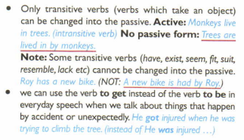
Passive

Slide 12
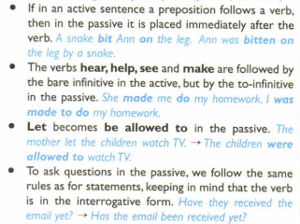
Passive

Slide 13
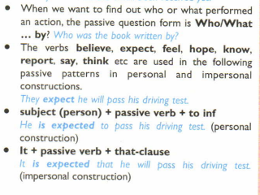
Passive

Slide 14
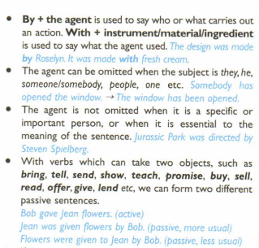
Passive

Slide 15
Rewrite the sentences in the passive
Rainforests regulate the Earth’s weather.
Scientists have Investigated only 2 per cent of 250.000 known plant species for their possible medicinal value.
Environmentalists are constantly developing projects to ensure the survival of the ecosystem.
Governments and elected officials will need to pass tougher environmental laws.
The oil exploration business nearly drove the Hawaiian monk seal to extinction.
Greenpeace had been protecting the environment long before It became fashionable.
Whalers had hunted the blue whale almost to extinction.
According to some estimates, countries will have reduced greenhouse emissions in five years.
The dodo had never faced a predator before humans invaded Its natural habitat
Illegal hunters are going to destroy the elephant population.

Slide 16
Rewrite the sentences in the passive
The Earth’s weather is regulated by the rainforests.
Only 2 per cent of 250,000 known plant species have been investigated for their possible medical value.
Projects to ensure the survival of the ecosystem are constantly being developed by environmentalists.
Tougher environmental laws will need to be passed.
The Hawaiian monk seal was nearly driven to extinction by the oil exploration business.
The environment was being protected by Greenpeace long before it became fashionable.
The blue whale had been hunted almost to extinction.
According to some estimates, greenhouse gas emissions will have been reduced in five years.
The dodo had never been faced with a predator before its natural habitat was invaded by humans.
The elephant population is going to be destroyed by illegal hunters.

Slide 17
Rewrite the following text in the passive
The World Wide Fund for Nature protects hundreds of species around the world. These species need special measures and extra protection if they are to survive. The WWF is currently funding over 2.000 projects. It also employs almost 4.000 people across the planet but it always needs more support from the public. Only the public can ensure a living planet for future generations.
e.g. Hundreds of species around the world are protected by the World Wide fund for Nature.

Slide 18
Rewrite the following text in the passive
Hundreds of species around the world are protected by the World Wide Fund for Nature, but special attention is focused on endangered species. Special measures and extra protection are needed for these species if they are to survive. Over 2,000 projects are currently being funded by the WWF. Also, almost 4,000 people across the planet are employed by the WWF, but more support from the public is always needed. A living planet for future generations can only be ensured by the public.

Slide 19
Read the text and complete gaps
1) ______ are very concerned about the ever- growing number of 2) ______ species In the world. 3) ______ problems such as freak weather conditions, fire and acid rain are resulting in the 4) ______ of vast areas of woodland and forest These areas are home to large numbers of animals and. As the land is vital to their 5) ______, this is having 6) ______. 7) ______ advocate the use of ozone-friendly products and recycling to achieve a 8) ______ in environmental damage. Safari parks have also been established In an attempt to give 9) ______ to animals from big-game hunters. Numbers are slowly beginning to Increase and will 10) ______ continue to do so In the future.

Slide 20
Read the text and complete gaps
1) CONSERVATIONISTS are very concerned about the ever- growing number of
2) ENDANGERED species In the world.
3) ENVIRONMENTAL problems such as freak weather conditions, fire and acid rain are resulting in the
4) DESTRUCTION of vast areas of woodland and forest These areas are home to large numbers of animals and. As the land is vital to their
5) SURVIVAL, this is having
6) ALARMING effects.
7) ECOLOGISTS advocate the use of ozone-friendly products and recycling to achieve
a 8) REDUCTION in environmental damage. Safari parks have also been established In an attempt to give
9) PROTECTION to animals from big-game hunters. Numbers are slowly beginning to Increase and will
10) HOPEFULLY continue to do so in the future.

Slide 21
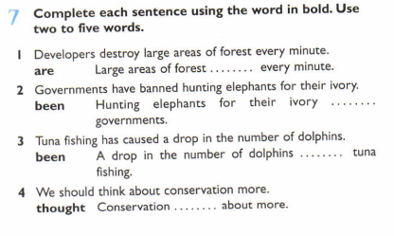
Complete each sentence using the word in bold. Use two to five words.
Large areas of forest ARE BEING DESTROYED every minute.
2. Hunting elephants for their ivory HAS BEEN BANNED BY governments.
3. A drop in the number of dolphins HAS BEEN CAUSED BY tuna fishing.
4. Conservation SHOULD BE THOUGHT about more.

Slide 22
FUN - Translation
1. Сотни видов животных охраняются специальным фондом по защите природы.
2. Популяция китов будет уничтожена незаконными охотниками.
3. Законы по защите окружающей среды разрабатываются государством.
4. Наш мир создал угрозу для окружающей среды.
5. Тигры всегда являлись одиночными животными до того, как их поселили в зоопарках.

Slide 23

Thanks for your work!

