Slide 1
Module 4

Slide 2

I was struggling to get by, I had just moved to Gloucester [ˈɡlɒstər] from London and had taken the first job that I was offered as a cashier [kæˈʃɪə] in a local supermarket. I was barely earning enough to do my weekly shopping and I yearned [jɜːn] for the money I used to make back in London. As I couldn’t afford my own place, I had settled for my best friend’s sofa, but the hard cushions [kʊʃn]and backaches [ˈbækeɪk] had made me realise that, above all else, I craved my old flat - my little sanctuary [ˈsæŋkʧʊ(ə)rɪ]! I soon began to wonder if moving had been the right decision. That’s when I heard a radio advert that changed my life…

Slide 3

“Looking for your own place but dreading the cost? Worry no more! You could live free for a year in the ‘Enviro-House’, one of Britain’s first environmentally friendly homes. We’re looking for a resident to live rent-free! For more details, visit www...” My friend had heard about this ‘carbon /ˈkɑːbən/-neutral’ house and he thought that it would be very difficult to stick to an energy-conserving routine. I should have considered this, or at least have been concerned about how many ‘guests’ would actually pass through. But, as I sat on the painfully uncomfortable sofa, the only thing in my head were the words... ‘Live free, live free.’

Slide 4

I visited the website and entered the competition to become an ‘eco-housemate’. I was one of three lucky finalists who had to battle it out for a place in the house live on local television. We had to cook a meal for five judges using a solar cooker and only organic vegetables and then face questions from the studio audience [ˈɔːdɪəns]. The judges weren’t impressed with my cooking and I thought I had lost. But, as I looked at my friends in the studio audience they all gave me smiles and the ‘thumbs up’ and it was just the confidence boost I needed. Thankfully, I made the audience laugh, they liked me and I was voted into the house.

Slide 5

The other finalists were keen environmentalists with a passion for the issue, unlike me. I had never really given it much attention to be honest, as it was insignificant [ɪnsɪgˈnɪfɪkənt] to me. I joked with the audience that the only way I was going to learn was if they sent me to the house! They agreed. As I moved into the house and tried to prepare for a drastic change [ˈdræstɪk ʧeɪnʤ] in lifestyle, I suddenly became nervous and asked myself if I had considered everything thoroughly.

Slide 6

As I walked through the front door, I had worrying visions of living in a futuristic house, full of high-tech gadgets. I certainly wouldn’t have been surprised to see a number of complex-looking machines. However, I was shocked to see the house was completely normal. In fact, it looked just like any other house. This eased /ˈizd/ my mind a bit, as I rarely find modem technology easy to understand, I prefer the simple life.

Slide 7
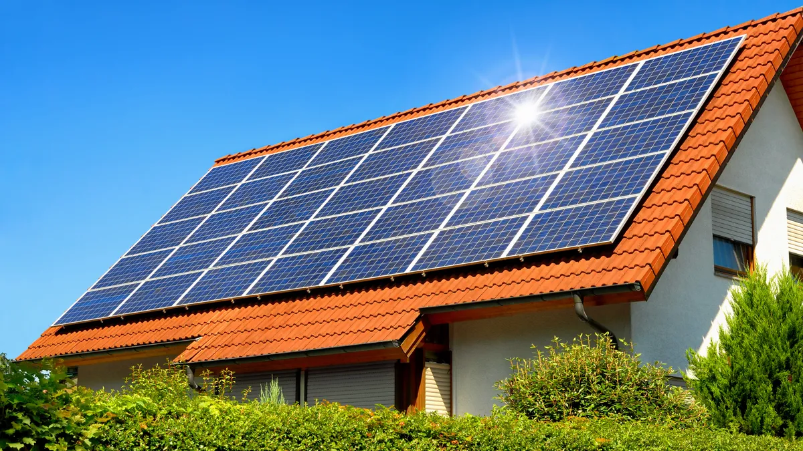

The heating system, water supply and electricity [ɪlekˈtrɪsɪtɪ] all worked in exactly the same way as they would in any other house in the UK. The only difference was that the house used renewable /rɪˈnjuː.ə.bəl/ sources of energy. At first I thought the house would definitely need some fossil fuels [fɒsl fuels], like coal and gas, but instead, solar panels [ˈsəʊlər pænlz] and small wind turbines [waɪnd ˈtɜːbaɪnz] (which could be a little noisy at times!) were used to provide the hot water and electricity. The house didn’t burn wood or oil either because smoke pollutes the atmosphere.

Slide 8

My experiences in the house made me look at the way I had lived my life in the past and how I should live it in the future. For example, it’s neither difficult nor time-consuming [taɪm kənˈsjuːmɪŋ] to recycle, as long as you make it part of your daily routine. I also changed my perspective on which energy sources to use. I used to think solar panels were too expensive, but now I realise that although the initial cost is high, they actually save a lot of money over time. I’ve recognised that spending a few extra pounds is preferable to losing our beautiful planet. It’s very simple to make those all-important changes; we just need the motivation to make them.

Slide 9
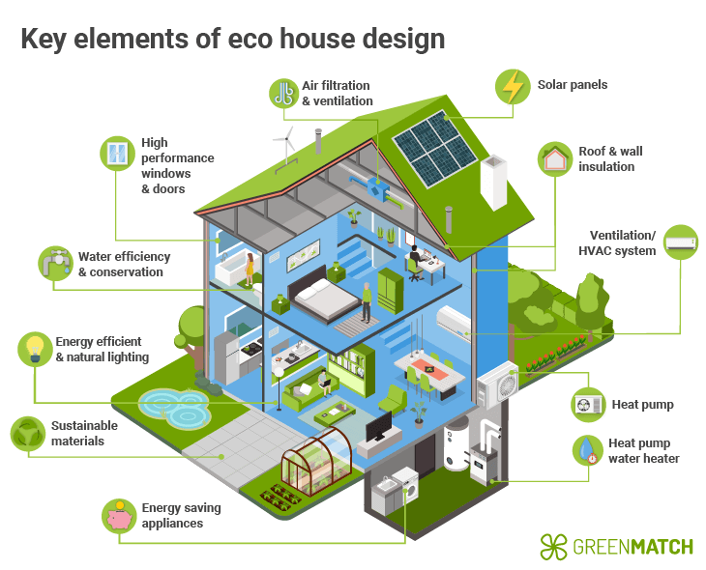
Would you like to live in an environmentally friendly house?

Slide 10
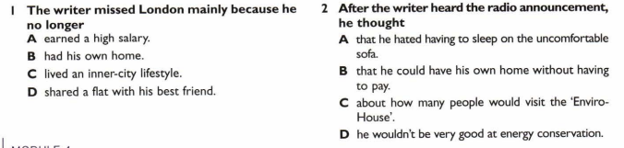
For statements 1 -7, choose А, В, C or D to complete each statement correctly

Slide 11
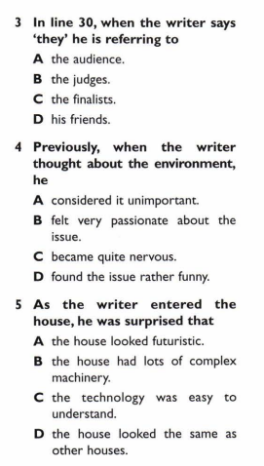
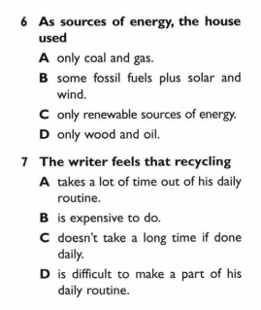
For statements 1 -7, choose А, В, C or D to complete each statement correctly

Slide 12
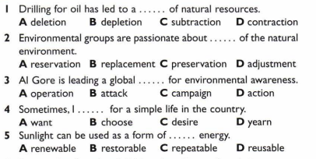
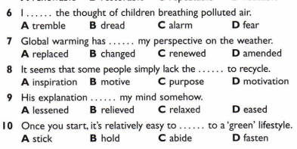
Choose the correct word to complete the sentences

Slide 13
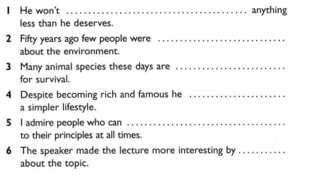
Fill in: struggle, long for, settle for, stick, concern, joke in the correct tense
settle for
concerned
struggling
longs for
stick
joking

Slide 14
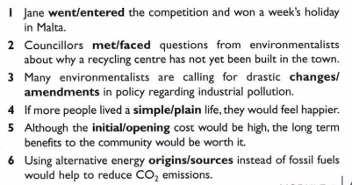
Choose the correct word

Slide 15

What new expression or word do you remember the most and why?

Slide 16

Thanks for your work!

