Slide 1
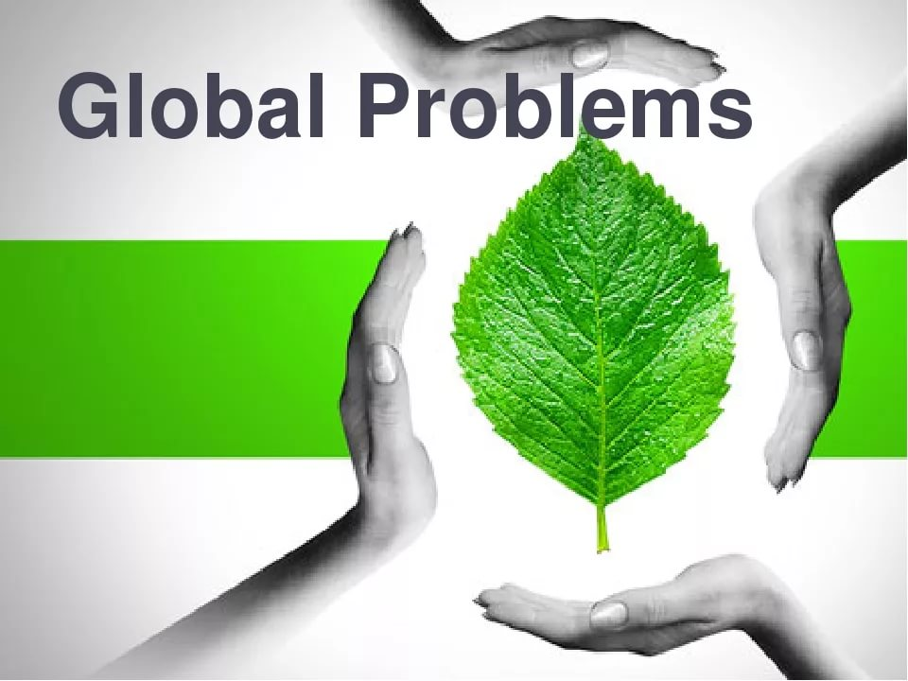
Global issues

Slide 2
What global problems do we have today?
War
Poverty
Famine
Global warming
Endangered species
Pollution
Child labour
Homelessness

Slide 3
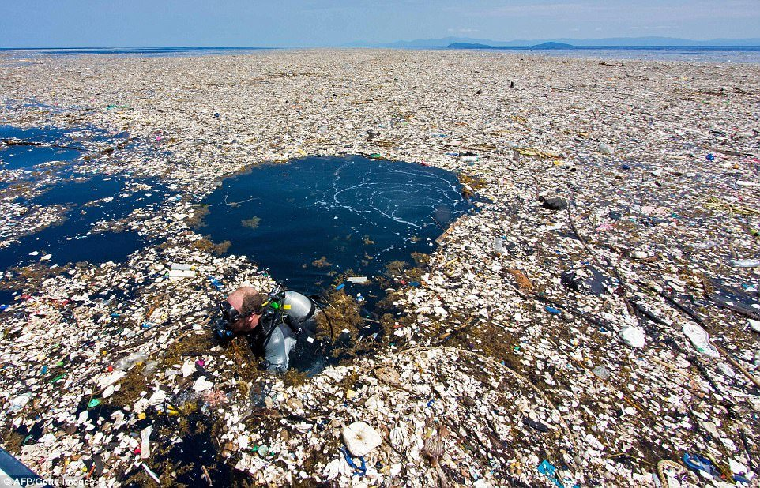
Pollution
Pollution is a global problem. Plastic in the oceans forms the Great Pacific Garbage Patch.

Slide 4
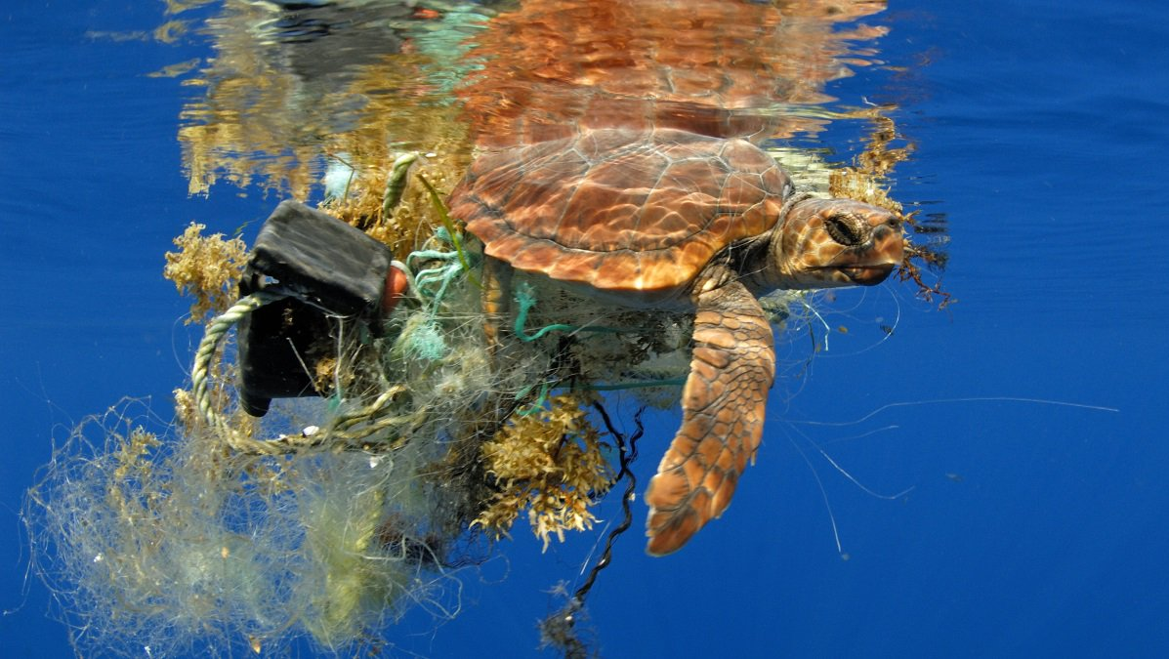
Animals species are dyeing

Slide 5
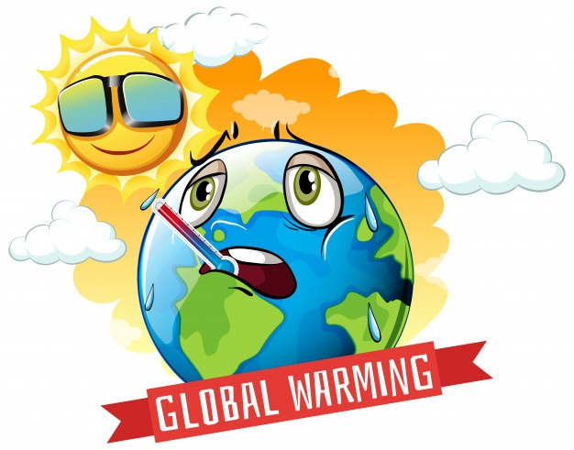
Global warming

Slide 6
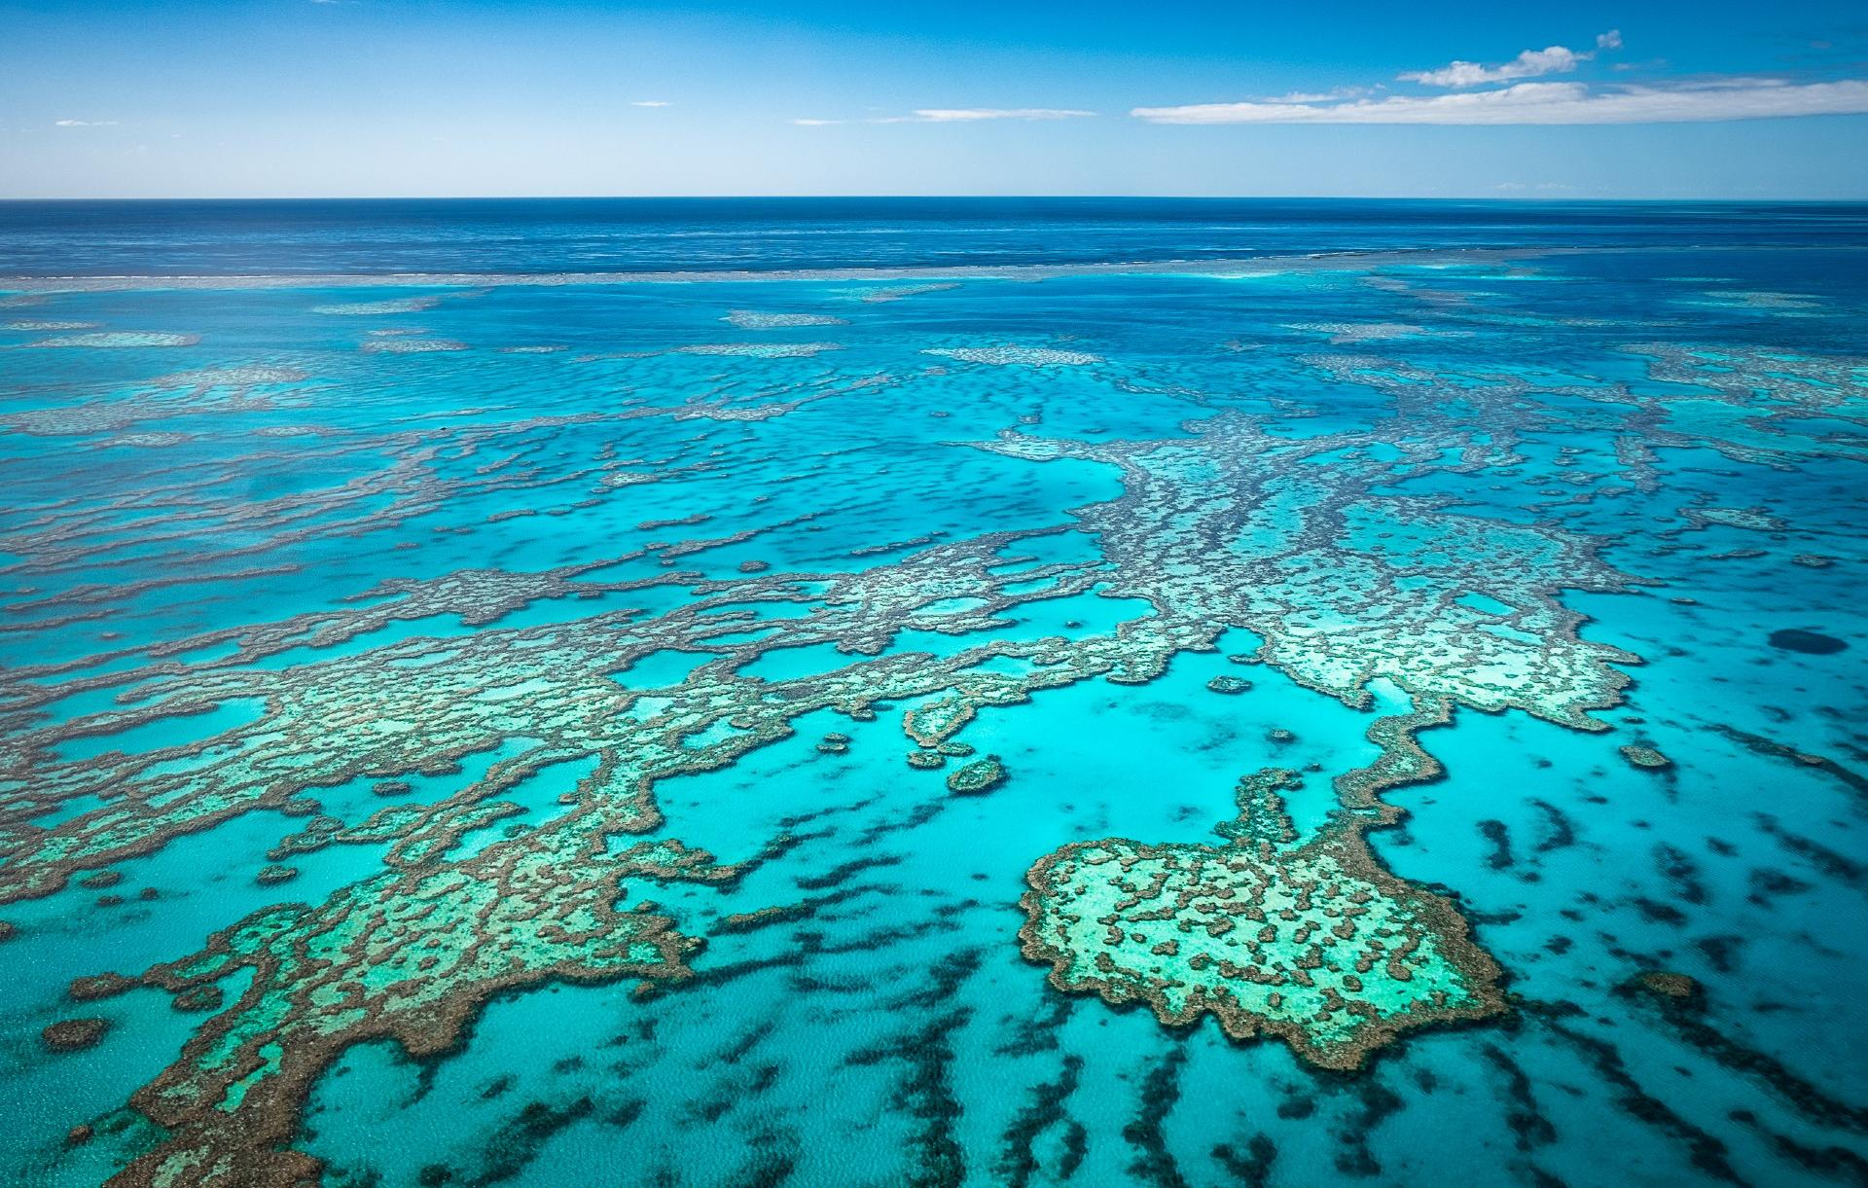
The Great Barrier Reef in Australia is in danger because of the global warming.

Slide 7
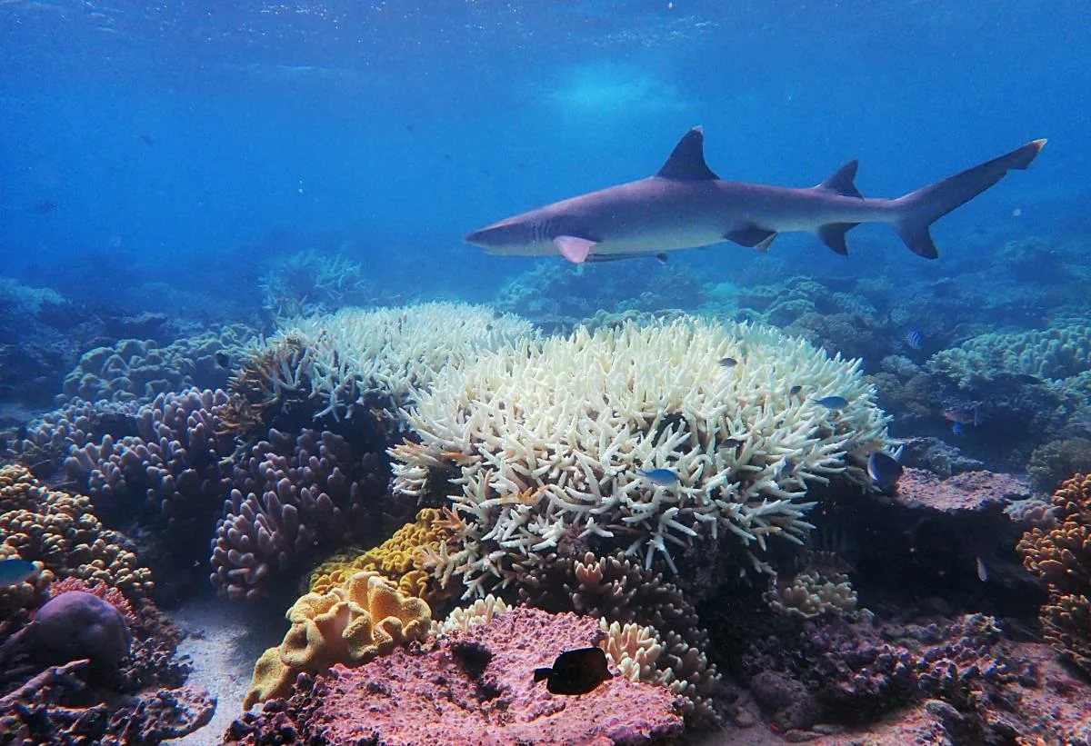
The Great Barrier Reef is considered to be one of the seven natural wonders of the world and is the largest living structure on the planet. It's even visible from space.

Slide 8
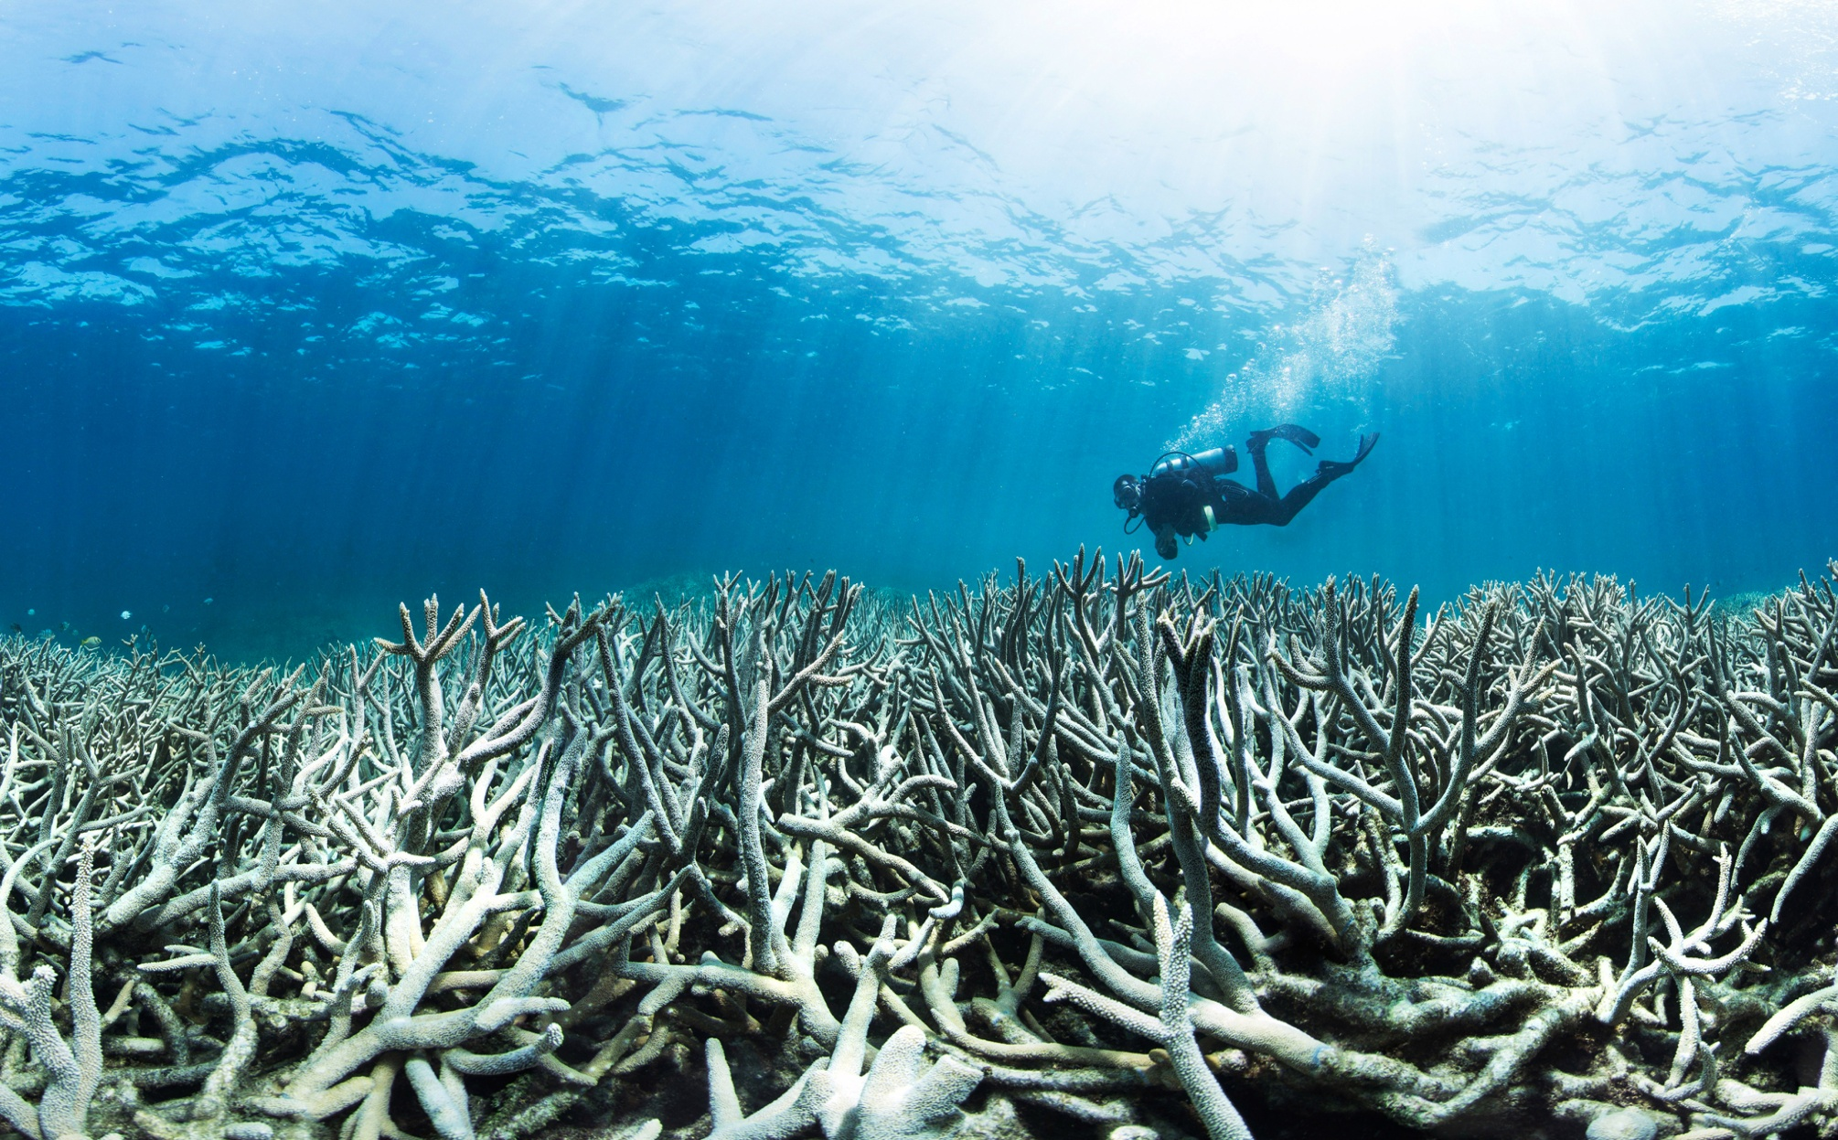
The reef coral bleaching leads to their deaths. A lot of fish and other marine animals loose their habitat.

Slide 9
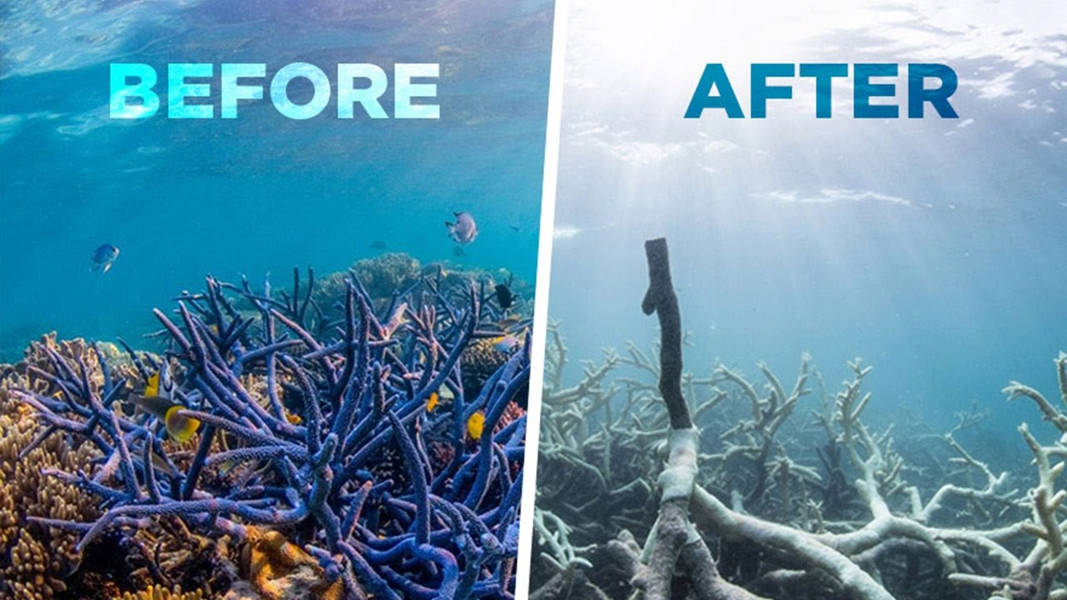

Slide 10
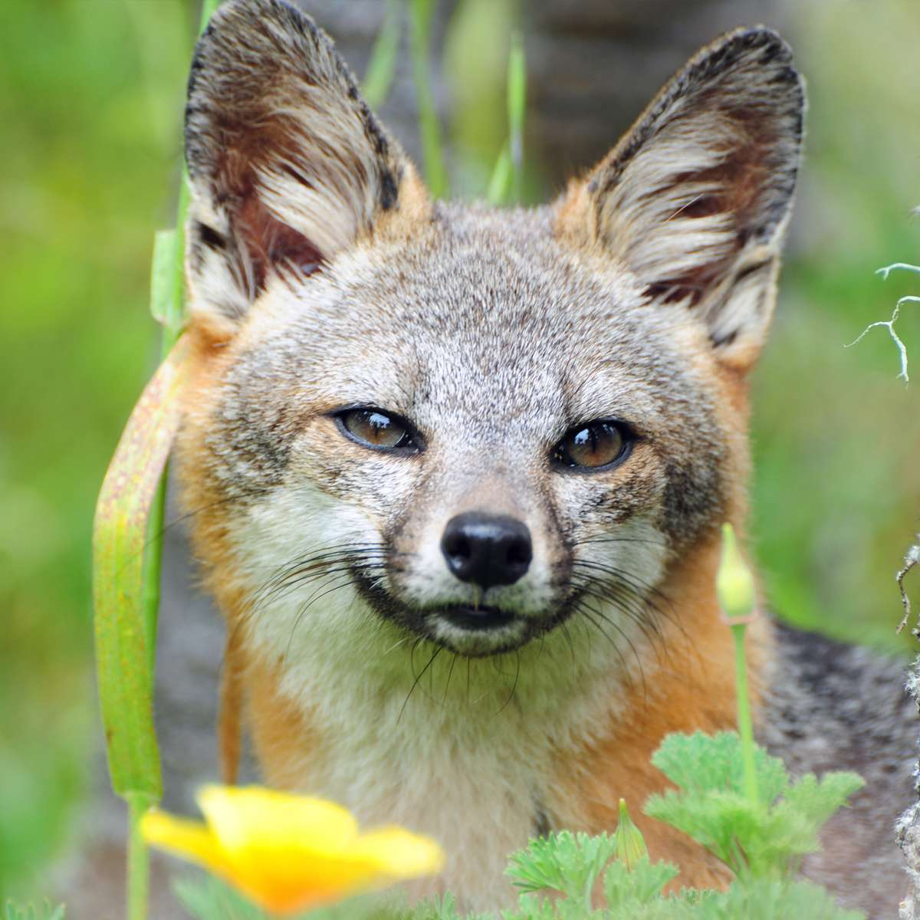
Endangered species
An endangered species is a type of organism that is threatened by extinction.

Slide 11
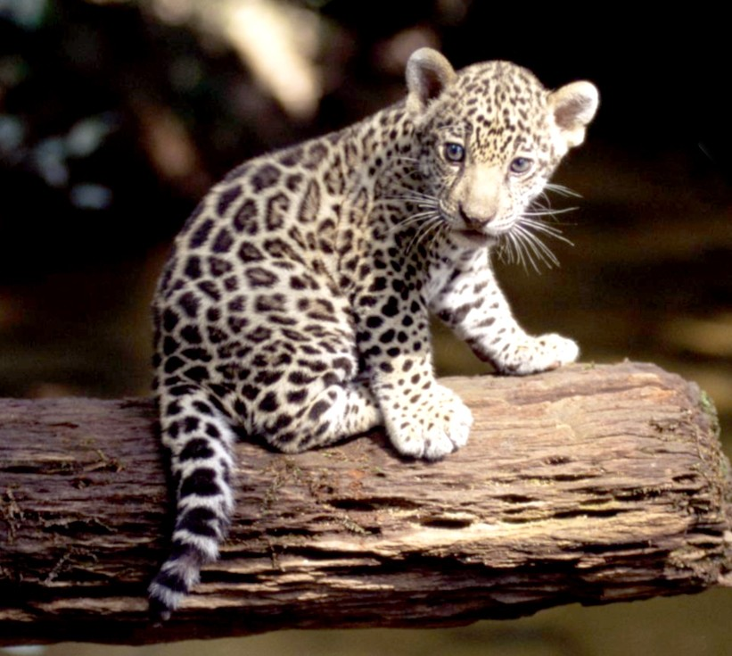
Loss of habitat, human impact reduce the populations of many animals

Slide 12
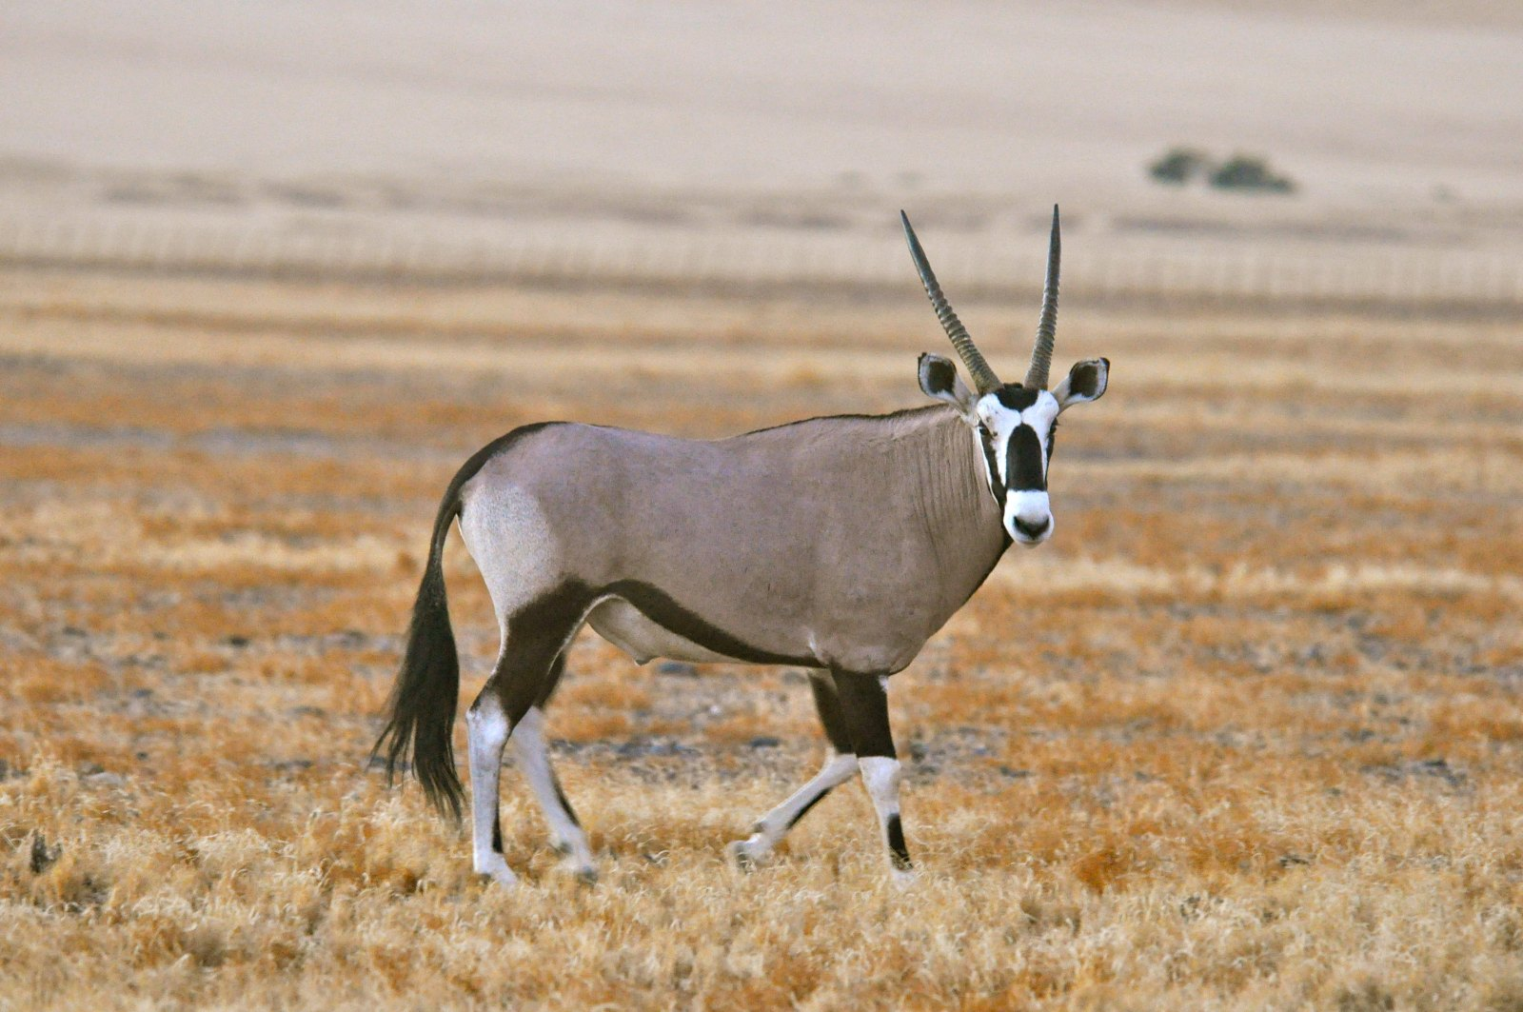
Extinct species
Oryx

Slide 13
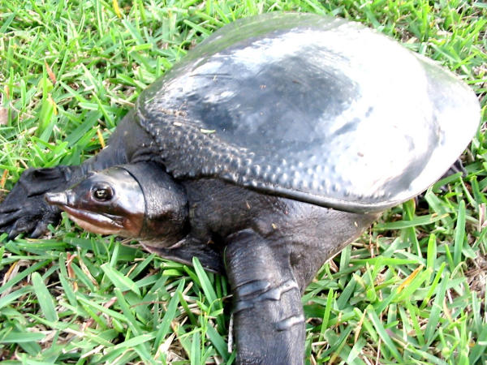
The black soft-shell turtle

Slide 14
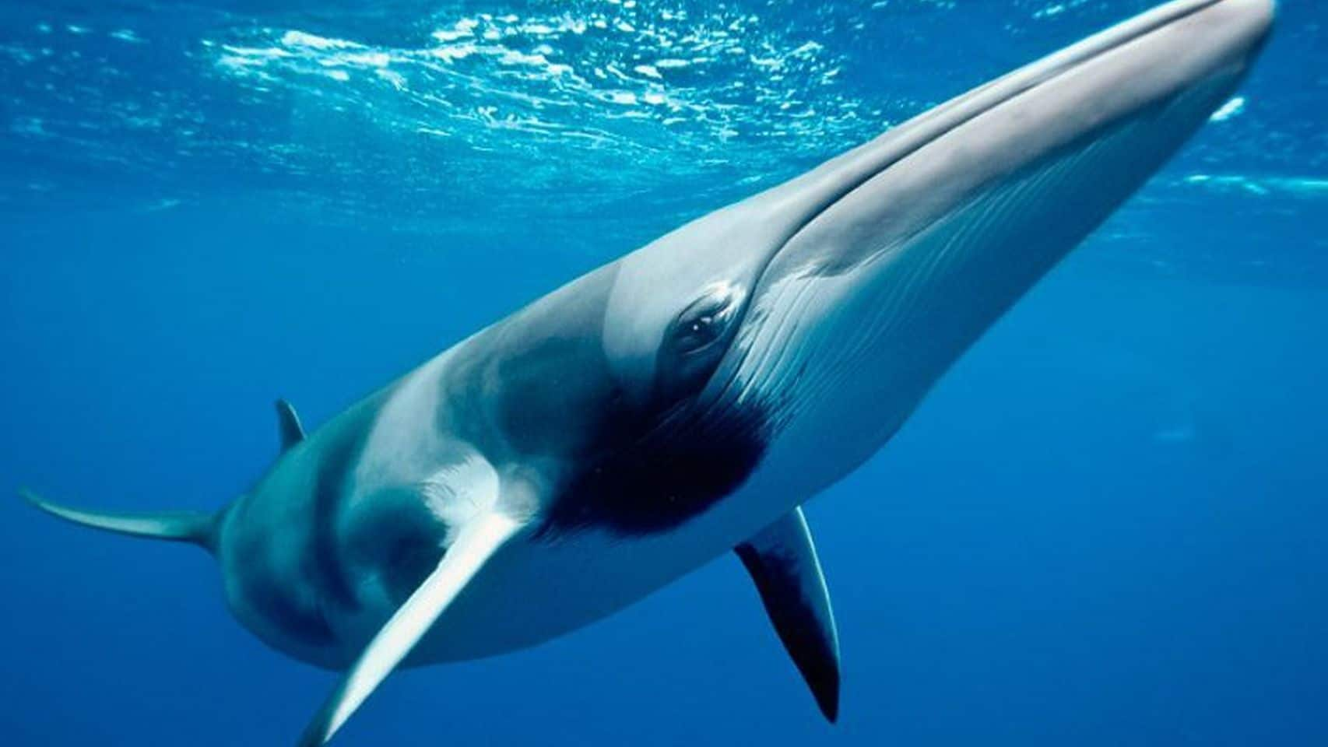
Sei whale

Slide 15
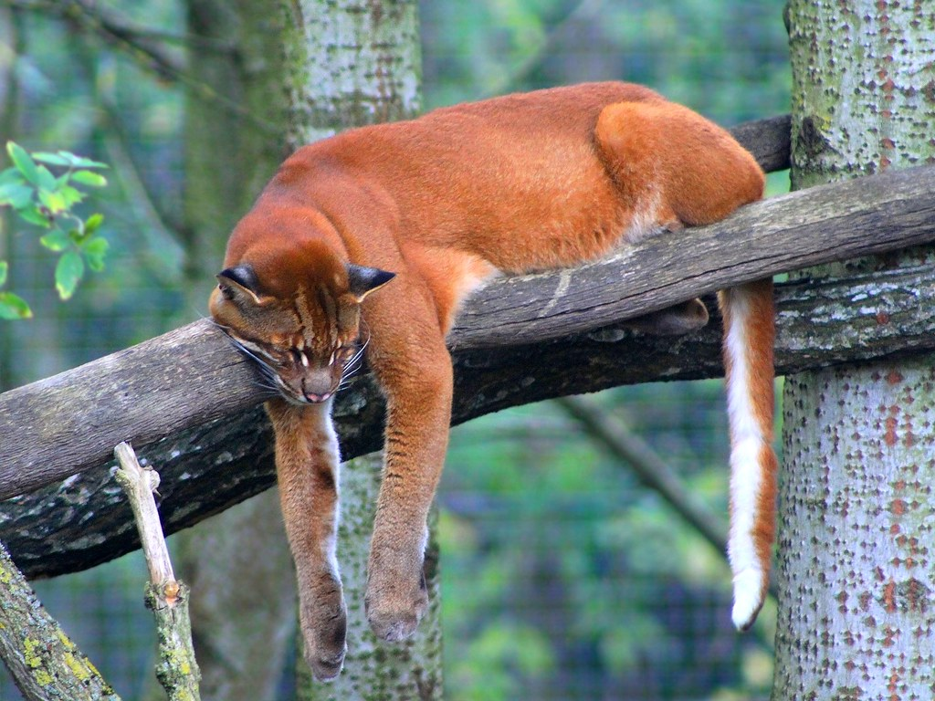
Bay cat

Slide 16
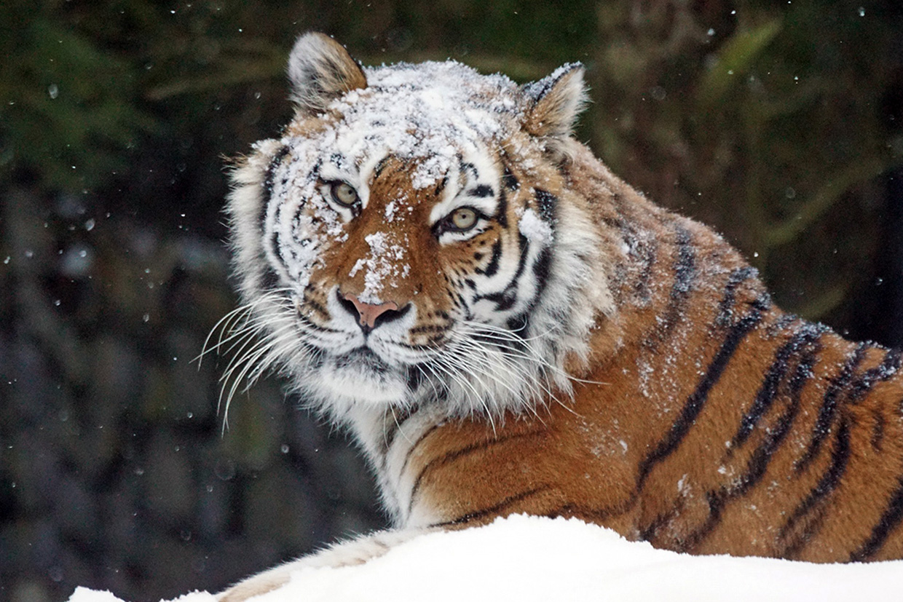
Siberian tiger

Slide 17
Global environmental problems occur beyond individual countries or regions. They are very dangerous and can result in degradation of humanity. But sometimes we don’t notice the environmental problems that surround us. Let’s discuss the problems of our region.

Slide 18
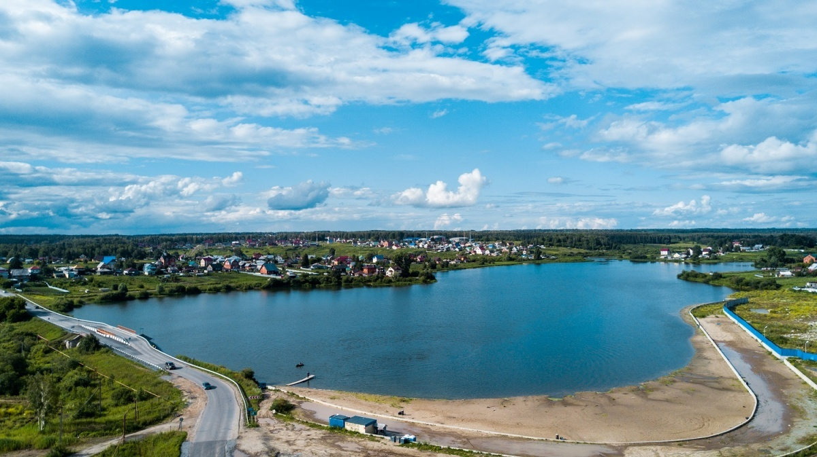
Environmental problems of Kamenka

Slide 19
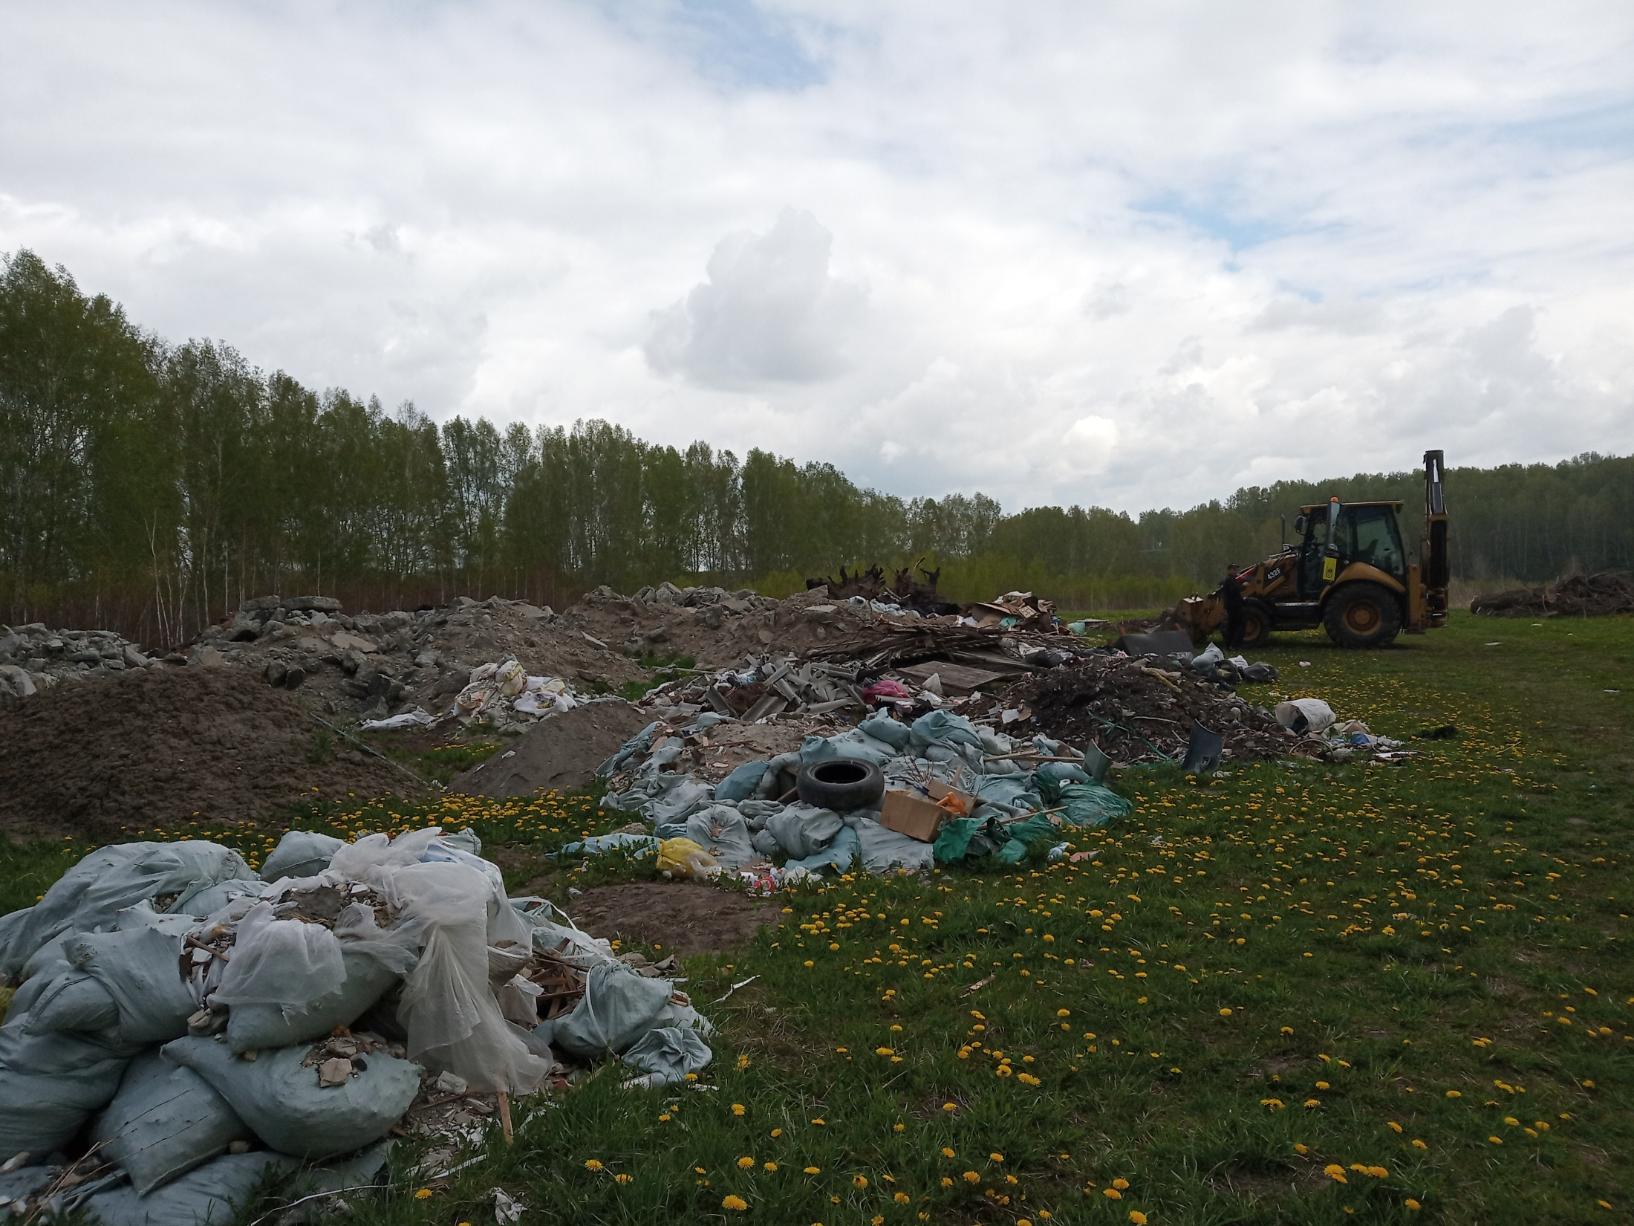
Pollution

Slide 20
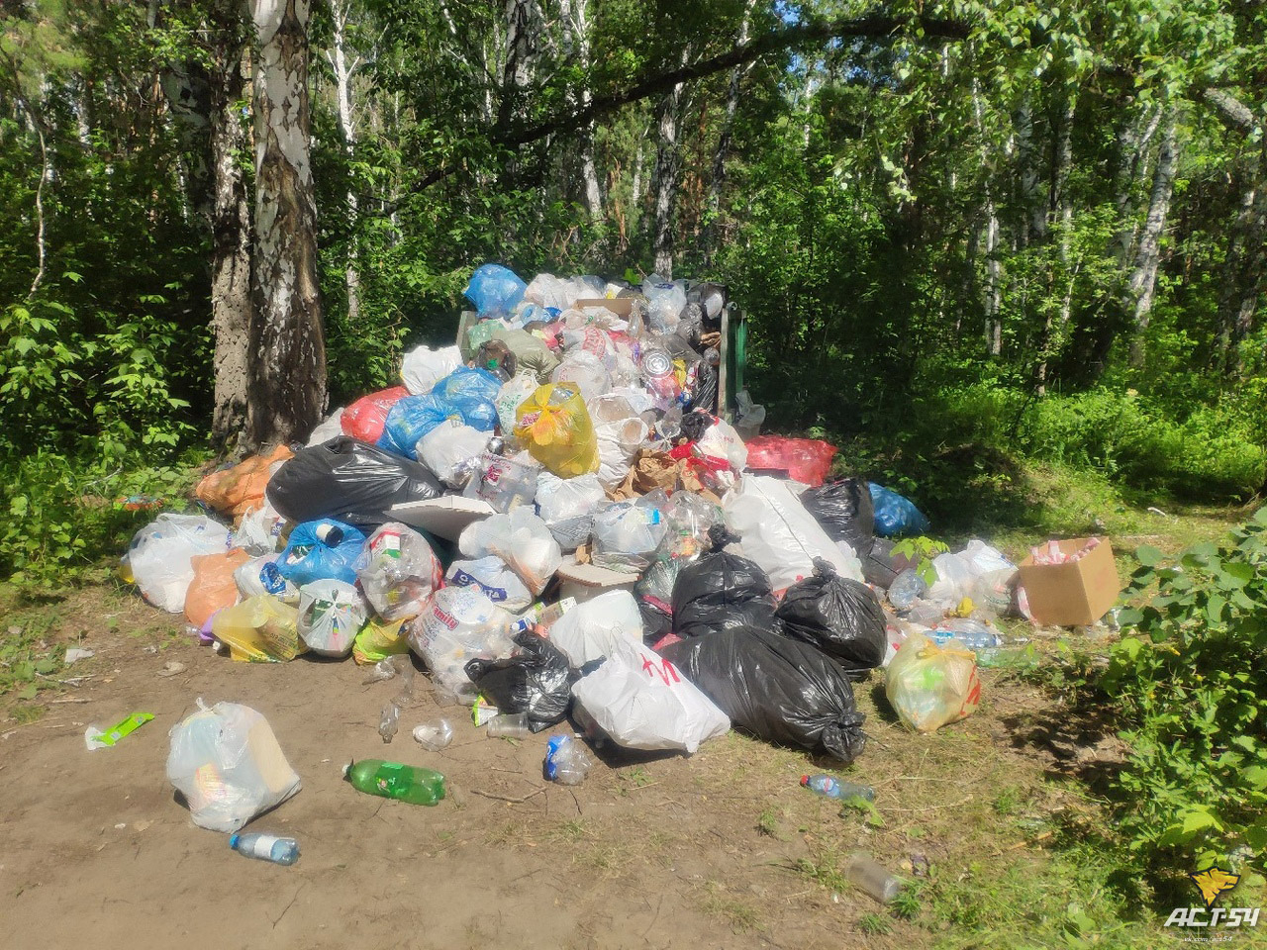
People throw away millions tons of rubbish every year. It harms people, animals, plants and trees. It poisons our soil, water and air.

Slide 21
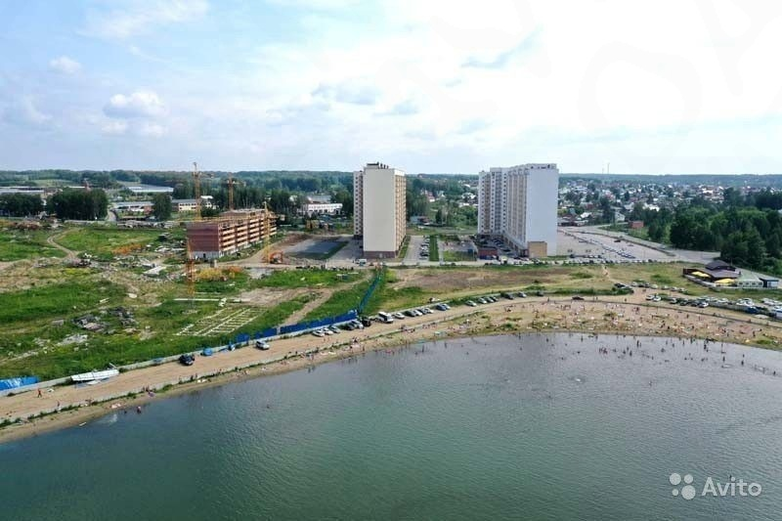
In summer a lot of people leave rubbish near the lake.

Slide 22
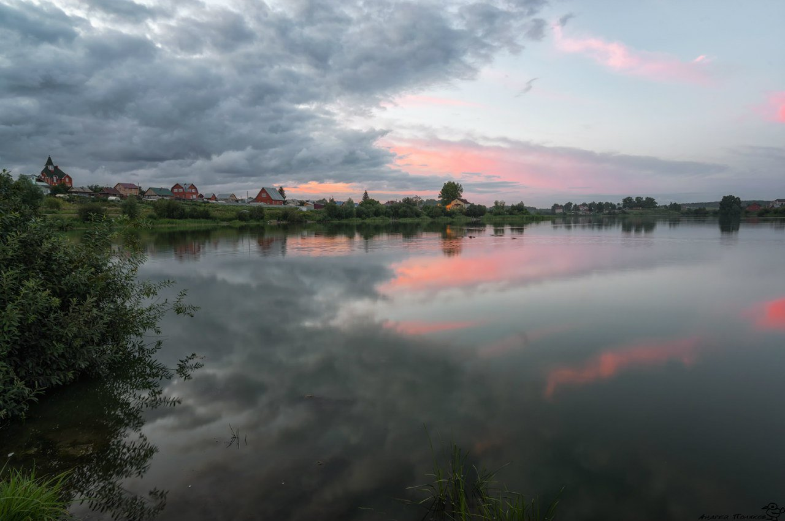
Nevertheless, it’s a very beautiful place. A lot of people spend time here, go swimming and fishing.

Slide 23
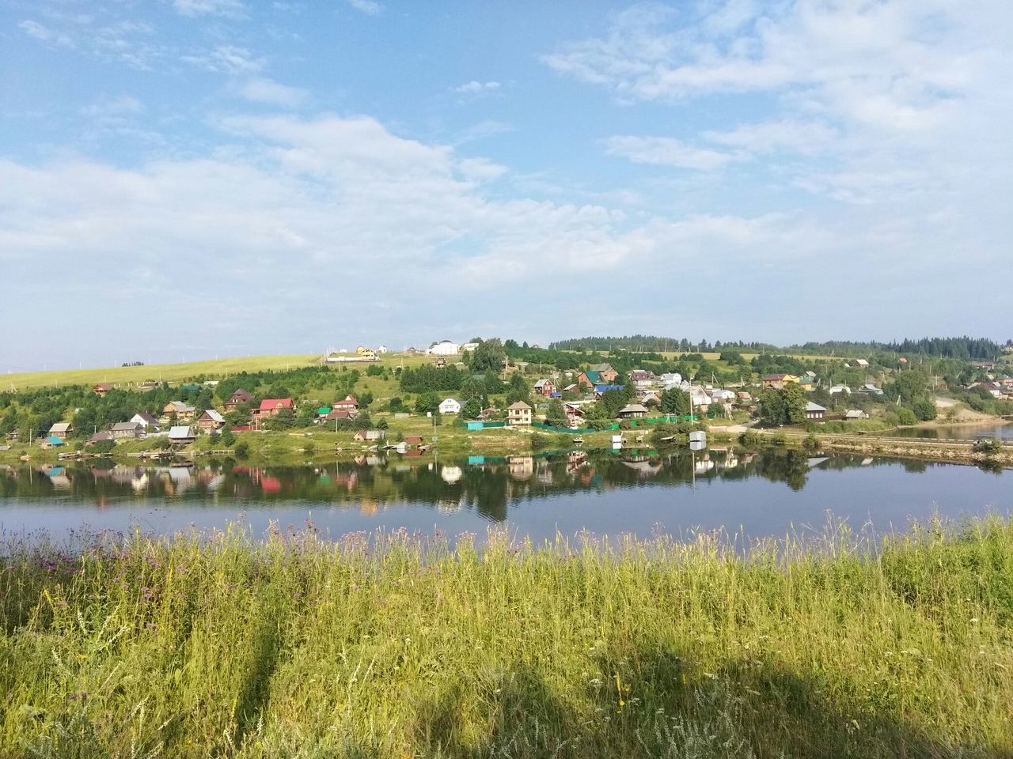
We should safe our lake

Slide 24
Lets do the task using new words. Fill in the missing words
Wars, pollution, global warming, poverty, famine, homeless
1. Water ____ leads to fish species dying.
2. ____ people have no place to live.
3. _____ is dangerous for The Great Barrier Reef .
4.A lot of people in Africa die because of the ____
5. I think all the conflicts may be solved without ___
6. Many people in the world live on less than 1% a day. They live in a total ____

Slide 25
Список ресурсов
https://edition.cnn.com/2018/04/18/world/great-barrier-reef-coral-dying-climate-change/index.html
https://www.nationalgeographic.org/encyclopedia/pollution/
https://www.conserve-energy-future.com/15-current-environmental-problems.php
https://www.nsktv.ru/news/obshchestvo/zhiltsy_kamenki_pozhalovalis_na_zastroyshchika_on_razvoroshil_khranilishche_opasnykh_otkhodov__150620190945/
http://www.nsk49.ru/index.php?id=9&tx_ttnews%5Btt_news%5D=16614

